Slide 1
George Mason University Secondary Education (SEED) Program
An Informational Presentation
November 2020

Slide 2
Introductions
Dr. Kristien Zenkov, Academic Program Coordinator/English Education Faculty-Advisor
TC Williams HS/Hammond MS (ACPS) University Facilitator
kzenkov@gmu.edu
Dr. Erin Peters Burton, Science Education Faculty-Advisor
Dominion HS/Seneca Ridge MS (LCPS) University Facilitator
epeters1@gmu.edu
Dr. Mark Helmsing, Social Studies Education Faculty-Advisor
Lake Braddock Secondary School (FCPS) University Facilitator
mhelmsin@gmu.edu
Dr. Erdogan Kaya, Computer Science Education Faculty-Advisor
Marshall HS/Kilmer MS (FCPS) University Facilitator
ekaya3@gmu.edu
Dr. Theresa Wills, Mathematics Education Faculty-Advisor
twills@gmu.edu
Dr. Jennifer Drake Patrick, Literacy Faculty Member
West Potomac HS/Sandburg MS (FCPS) University Facilitator
jdrakepa@gmu.edu
Ms. Mathilde Speier, Program Office Manager & Outreach Specialist
mspeier@gmu.edu, 703-993-3696

Slide 3
Introductions, continued
Ms. Lisa Green, Lead Supervisor/Robinson Secondary School (FCPS) University Facilitator
lgreen@gmu.edu
Ms. Christine Forester, Champe HS/Mercer MS (LCPS) University Facilitator
cforeste@gmu.edu
Ms. Marion Taousakis, Osbourn Park HS/Saunders MS (PWCS) University Facilitator
mtaousak@masonlive.gmu.edu
Mr. Andrew Porter, Chantilly HS/Rocky Run MS (FCPS) University Facilitator
aporter7@masonlive.gmu.edu
Ms. Kerri Marianos, BAM/Undergraduate Advisor, kmariano@gmu.edu, 703-993-3539
Ms. Mary Slone, Endorsement Specialist, endorse@gmu.edu, 703-993-1745/3539
Dr. Roberto Pamas, Director of Office of Educator Preparation/TeacherTrack, rpamas@gmu.edu
Ms. Stacy Wilson, Clinical Experience Specialist, swilsono@gmu.edu
Ms. Rebekah Flis, Licensure Specialist, edlicens@gmu.edu, 703-993-2094

Slide 4
Licensure Areas
Biology
Chemistry
Earth Science
Physics
English
History/Social Studies
Mathematics
Computer Science

Slide 5
The SEED (Secondary Education) Program
Options @ Mason
Graduate Licensure
Undergraduate Licensure Certificate
Bachelors-to-Accelerated-Masters (BAM) Degree, w/ Licensure
Master of Education Degree w/ Licensure

Slide 6
Master of Education Degree: 35 credits Graduate Licensure Certificate: 23 credits Undergraduate Licensure Certificate: 23 credits
First 15 credits of coursework, 6-credit internship, and 2-credit internship seminar make up licensure component for individuals who are pursuing a full, initial license or who need to satisfy the state’s requirements for a provisional license
Those who successfully complete the licensure component of the program either take 12 additional credits to earn a Master of Education (M.Ed.) degree*
Fall/Spring classes meet once per week, 4:30 - 7:10 pm or 7:20 - 10 pm, M-Th
Summer courses meet 2-3 times per week over 4 or more weeks
Note: All semesters have associated clinical work during school hours in a SEED partnership school; internship begins week BEFORE Mason semester start
*If you applied for the Graduate Licensure Certificate you cannot change to the MEd degree after completing any coursework

Slide 7
The SEED “Seeds”
Inquiry & Reflection
Social Justice
Collaboration & Partnership
Respect for & Relationships with Students
Advocacy & Agency

Slide 8
Professional Dispositions
Openness to feedback
Continuous improvement/change orientation
High expectations for learning
Advocacy
Professionalism
Legal and ethical conduct

Slide 9
A “Clinical Continuum”
The Secondary Education (SEED) program envisions teacher candidates’ development across a five stage continuum:
Stage 1: Application and “Lesson for Your Life”
Stage 2: Foundations course and initial fieldwork, including a community focus
Stage 3: Methods I courses, with observations and 1:1, small group, and project work in partner schools
Stage 4: Methods II courses, with teaching model lesson plus 1:1, small group, and project work in partner schools
Stage 5: Internship and taking on the role of a teacher
At each stage candidates grow in awareness of their teaching abilities, instructors and mentors assess and provide feedback on candidates’ teaching abilities, and both candidates and instructors evaluate candidates’ “fit” for the teaching profession.

Slide 10
Clinical Experiences and
Partnership Schools
SEED partners with sixteen area schools/divisions, where you will most likely complete all clinical experiences and your internship, moving between high schools and feeder middle schools:
Chantilly HS/Rocky Run MS (FCPS)
Lake Braddock SS (FCPS)
West Potomac HS/Sandburg MS (FCPS)
Marshall HS/Kilmer MS (FCPS)
Robinson SS (FCPS)
Osbourn Park HS/Saunders MS (PWCS)
TC Williams HS/Hammond MS (ACPS)
Dominion HS/Seneca Ridge MS (LCPS)
Champe HS/Mercer MS (LCPS)

Slide 11
Clinical Experiences and
Internship
You will be required to complete 15-50 clock hours of clinical experiences at a school during each semester in the program. The number of hours will depend on the number of courses you are taking and the courses’ requirements
Most licensure courses require clinical experiences
You will receive information from your professors on how to request a clinical experience placement for the semester.
You are required to complete all hours and show verification.
Think of these clinical experiences as a part of a long-term job interview! Demonstrate professionalism at all times!

Slide 12
Internship Options
Traditional: One full semester, full-time, unpaid; placed with a mentor teacher in a school; placed by Teacher Track Office; work with a full-time mentor teacher and a university supervisor.
On-the-job: One full semester, full-time, for candidates who have a provisional license and are teaching in their content area and meet all other necessary criteria (as determined by the Teacher Track Office); work with a part-time mentor teacher and a university supervisor.
Note: Internships follow school/mentor teachers’ schedules, rather than the Mason calendar. You MUST be available a minimum one week prior to the start of the Mason semester.

Slide 13
Internship
Application Deadlines and Endorsements
All “endorsement” courses and assessments (e.g., Praxis II and VCLA) must be completed PRIOR to applying for internship
Fall internship application deadline: February 15
Spring internship deadline: September 15
ALL endorsement coursework must be completed, with all transcripts submitted and approved by the CEHD Endorsement Office, prior to the internship application deadline. Since the internship application must be submitted in the semester prior to the actual internship, please make an appointment to meet with the Endorsement Specialist and plan the completion of your Endorsements accordingly.
Allow a minimum six weeks for the processing of test scores and assessments prior to the internship application deadline

Slide 14
Sample Course Sequence A: Fall Start (6-9 credits per semester = 4 semesters to licensure, 5 semesters to masters)
Fall I: 6 credits
Methods I (English/Math/Science/Social Studies/Computer Science) (3 credits)
SEED 440/540, “Human Development and Learning” (3 credits)
Spring I: 6-9 credits
Methods II (English/Math/Science/Social Studies/Computer Science) (3 credits)
EDRD 419/619, “Literacy in the Content Areas” (3 credits)
Summer I: 6 credits
SEED 422/522, “Foundations of Secondary Education” (3 credits)
Elective(s) (3-6 credits): Required English, math, science, social studies, computer science “selectives” ONLY offered in summer (3 credits)
Fall II: 8 credits
Note: Internship semester is full-time status w/ no other course enrollment/obligations
SEED 49-/79-, Internship (6 credits)
SEED 491/791, Internship Seminar (2 credits)
Spring II: 3-6 credits
Elective(s) (3-6 credits)
SEED 675, “Research in Secondary Education” (3 credits)

Slide 15
Sample Course Sequence B: Fall Start (8-9 credits per semester = 4 semesters to licensure AND masters)
Fall I: 9 credits
Methods I (English/Math/Science/Social Studies/Computer Science) (3 credits)
SEED 440/540, “Human Development and Learning” (3 credits)
Elective (3 credits)
Spring I: 9 credits
Methods II (English/Math/Science/Social Studies/Computer Science) (3 credits)
EDRD 419/619, “Literacy in the Content Areas” (3 credits)
Elective or SEED 675, “Research in Secondary Education” (3 credits)
Summer I: 9 credits
SEED 422/522, “Foundations of Secondary Education” (3 credits)
Elective(s) (6 credits): Required English, math, science, social studies, computer science “selectives” ONLY offered in summer (3 credits)
SEED 675, “Research in Secondary Education” (3 credits)
Fall II: 8 credits
Note: Internship semester is full-time status w/ no other course enrollment/obligations
SEED 49-/79-, Internship (6 credits)
SEED 491/791, Internship Seminar (2 credits)

Slide 16
Sample Course Sequence C: Spring Start (6-9 credits per semester = 4 semesters to licensure, 5 semesters to masters)
Spring I: 6 credits
Methods I (English, Math, Science, Social Studies, Computer Science) (3 credits)
SEED 440/540, “Human Development and Learning” (3 credits)
Summer I: 6-9 credits
SEED 422/522, “Foundations of Secondary Education” (3 credits)
Elective(s) (3 credits): Required English, science, math, social studies, computer science “selectives” ONLY offered in summer (3 credits)
Fall I: 6 credits
Methods II (English, Math, Science, Social Studies, or Computer Science) (3 credits)
EDRD 419/619, “Literacy in the Content Areas” (3 credits)
Spring II: 8 credits
Note: Internship semester is full-time status w/ no other course enrollment/obligations
SEED 49-/79-, Internship (6 credits)
SEED 491/791, Internship Seminar (2 credits)
Summer II: 3-9 credits
Elective(s) (3-6 credits)
SEED 675, “Research in Secondary Education” (3 credits)

Slide 17
Sample Course Sequence D: Spring Start (8-9 credits per semester = 4 semesters to licensure AND masters)
Spring I: 9 credits
Methods I (English, Math, Science, Social Studies, or Computer Science) (3 credits)
SEED 440/540, “Human Development and Learning” (3 credits)
Elective (3 credits)
Summer I: 9 credits
SEED 422/522, “Foundations of Secondary Education” (3 credits)
Elective(s) (6 credits): Required English, science, math, social studies, or computer science “selectives” ONLY offered in summer (3 credits)
SEED 675, “Research in Secondary Education” (3 credits)
Fall I: 9 credits
Methods II (English, Math, Science, Social Studies, or Computer Science) (3 credits)
EDRD 419/619, “Literacy in the Content Areas” (3 credits)
Elective or SEED 675, “Research in Secondary Education” (3 credits)
Spring II: 8 credits
Note: Internship semester is full-time status w/ no other course enrollment/obligations
SEED 49-/79-, Internship (6 credits)
SEED 491/791, Internship Seminar (2 credits)

Slide 18
Sample Course Sequence E: Summer Start (6-8 credits per semester = 5 semesters to licensure AND masters)
Summer I: 6-9 credits
SEED 422/522, “Foundations of Secondary Education” (3 credits)
Elective(s) (3-6 credits): Required English, science, math, social studies, or computer science “selectives” ONLY offered in summer (3 credits)
Fall I: 6 credits
Methods I (English, Math, Science, Social Studies, or Computer Science) (3 credits)
SEED 440/540, “Human Development and Learning” (3 credits)
Spring I: 6 credits
Methods II (English, Math, Science, Social Studies, or Computer Science) (3 credits)
EDRD 419/619, “Literacy in the Content Areas” (3 credits)
Summer II: 3-6 credits
Elective(s) (3-6 credits)
SEED 675, “Research in Secondary Education” (3 credits)
Fall II: 8 credits
Note: Internship semester is full-time status w/ no other course enrollment/obligations
SEED 49-/79-, Internship (6 credits)
SEED 491/791, Internship Seminar (2 credits)

Slide 19
Sample Course Sequence F: Summer Start (6-9 credits per semester in Fall/Spring = 5 semesters to licensure AND masters)
Summer I: 6-9 credits
SEED 422/522, “Foundations of Secondary Education” (3 credits)
Elective(s) (3-6 credits): Required English, science, math, social studies, or computer science “selectives” ONLY offered in summer (3 credits)
Fall I: 9 credits
Methods I (English, Math, Science, Social Studies, or Computer Science) (3 credits)
SEED 440/540, “Human Development and Learning” (3 credits)
Elective (3 credits)
Spring I: 6-9 credits
Methods II (English, Math, Science, Social Studies, or Computer Science) (3 credits)
EDRD 419/619, “Literacy in the Content Areas” (3 credits)
Optional: SEED 675, “Research in Secondary Education” (3 credits)
Summer II: 3 credits
Optional: SEED 675, “Research in Secondary Education” (3 credits)
Spring II: 8 credits
Note: Internship semester is full-time status w/ no other course enrollment/obligations
SEED 49-/79-, Internship (6 credits)
SEED 491/791, Internship Seminar (2 credits)

Slide 20
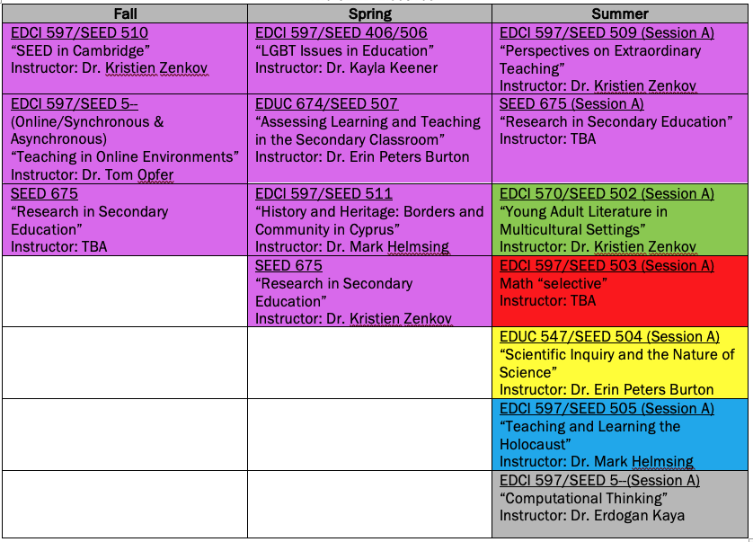
SEED Electives
Note: Each SEED subject area requires completion of one “selective”—a required elective (green, red, yellow, blue, or grey highlighted courses above); other electives are approved by subject area advisor

Slide 21
Why SEED @ Mason?
The partner school advantage and our partnership network
Dedicated subject area faculty/advisor
Cohort structure
Shortest masters licensure sequence in VA
Schools in NOVA—education matters here!
Salaries!
Career outlook and critical teacher shortage areas in VA 2018-19:
#3 Middle Education, Grades 6-8
#5 Mathematics Grades 6-12 (including Algebra 1)
#7 English (Secondary)
#8 Science (Secondary)

Slide 22
How Do I Get Admitted?
Your application will be evaluated using the following criteria:
Bachelor’s degree with a minimum 3.0 GPA in the last 60 credit hours of undergraduate coursework. We can consider those applicants who have below a 3.00 GPA, as long as they are strong in other areas.
Endorsement requirements fulfilled
Interview by SEED program faculty

Slide 23
Questions about SEED?
Dr. Kristien Zenkov
Academic Program Coordinator
kzenkov@gmu.edu
Ms. Mathilde Speier
Program Office Manager & Outreach Specialist
mspeier@gmu.edu
703-993-3696

