Slide 1
Initial License Application Online Process using VALO
GMU Licensure Coordinator
Email Edlicen@gmu.edu with questions

Slide 2
Step One: Obtaining your College Verification Form
Download a copy of the College Verification Form from the GMU Licensure Page
Complete Part I of the College Verification Form, but for security reasons, leave the SSN blank.
Email the CVF to the Licensure Coordinator at edlicen@gmu.edu along with your training certificates for:
  Child Abuse and Neglect Recognizing, Reporting, and Responding Training
  CPR/AED/Emergency First Aid
  Dyslexia Awareness Module
  Behavior Intervention and Support Training(also know as Restraint and Seclusion– done through ODU)
  Cultural Competency (if not included in your coursework)
  Information on how to obtain these certificates can be found here.

Slide 3
College Verification Form
Once you email the licensure coordinator at edlicen@gmu.edu, they will review your academic record to ensure all licensure requirements are satisfied and will complete the college verification form.
The College Verification Form can only be marked YES if all requirements have been met including all coursework, Internship, testing (if applicable), and Content Area Review (if applicable).
The licensure coordinator will return your completed College Verification Form to you. You will upload this completed form to your VALO account.

Slide 4
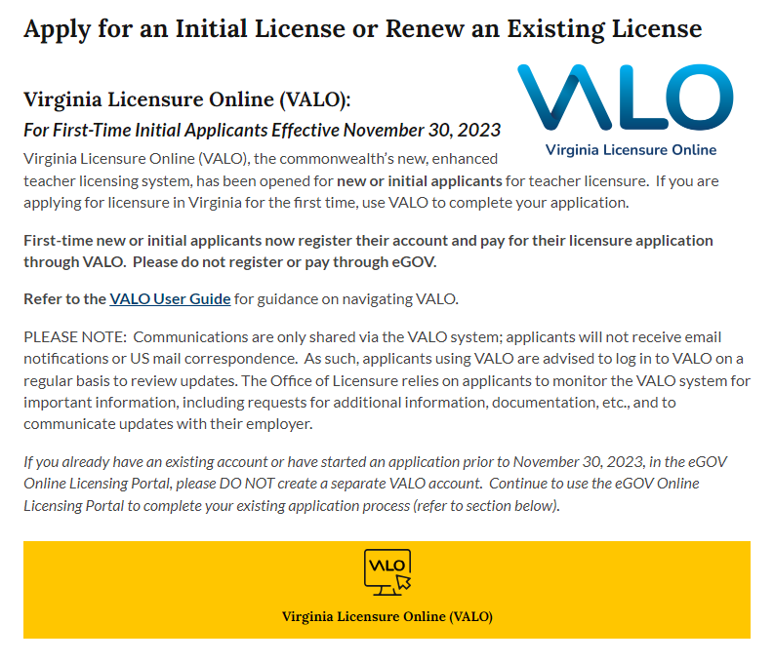
Step 2 – Access the VALO system
Visit the VDOE licensing services webpage
Click the yellow box that reads Virginia Licensure Online (VALO)

Slide 5
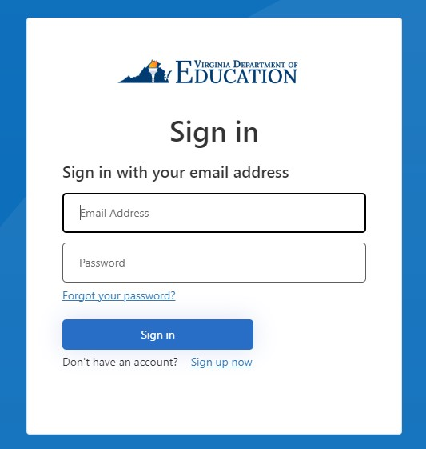
Create an account and sign in
Click sign up now

Slide 6
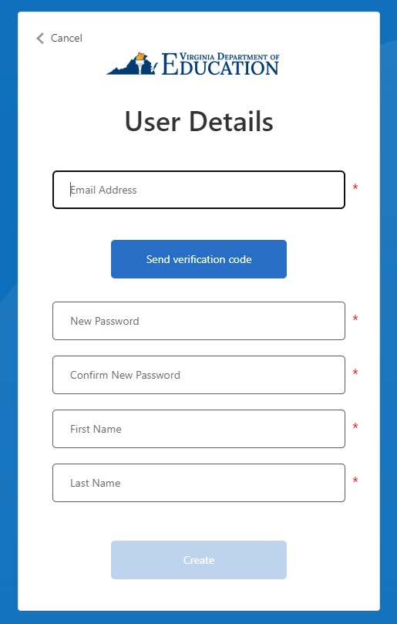
Create an account and sign in
Enter your email address
Click send verification code

Slide 7
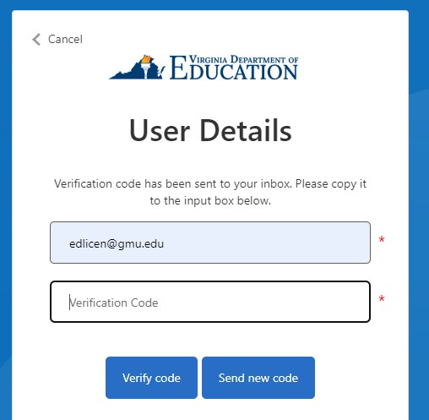
Create an account and sign in
Check your email for the verification code
Copy and paste the verification code in the box
Click verify code

Slide 8
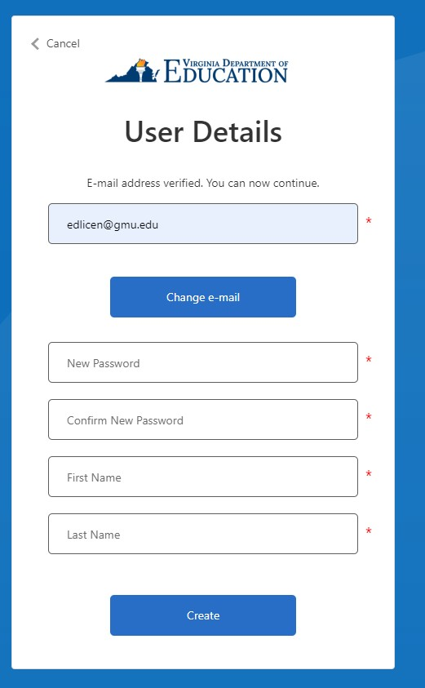
Create an account and sign in
Set your password
Enter your first and last name
Click create to make your account

Slide 9
Sign into your account
Enter your email and password
Click sign in

Slide 10
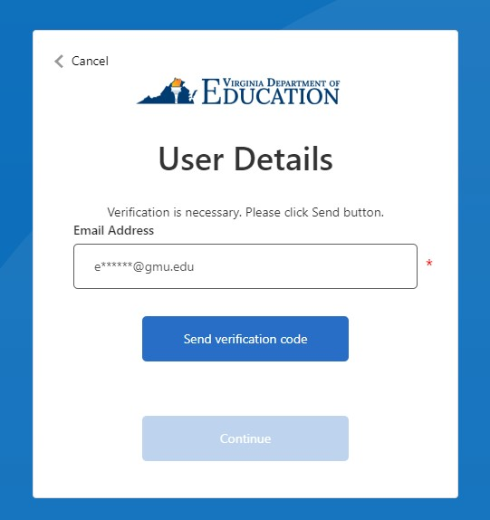
Sign into your account
Click send verification code
Enter verification code when prompted

Slide 11
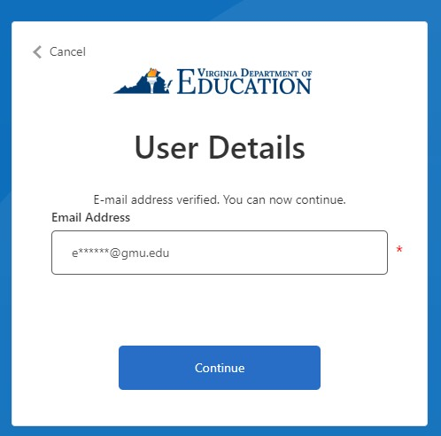
Verify email
Once you have entered the verification code click continue to access your account

Slide 12
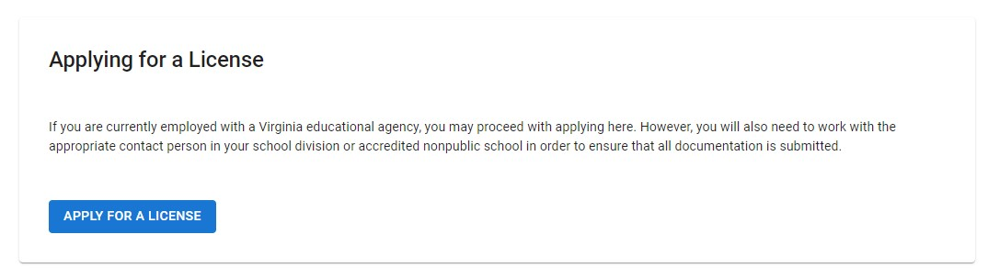
Start your application
In the top right corner you will see a box labeled Applying for a license
Click the apply for a license box

Slide 13
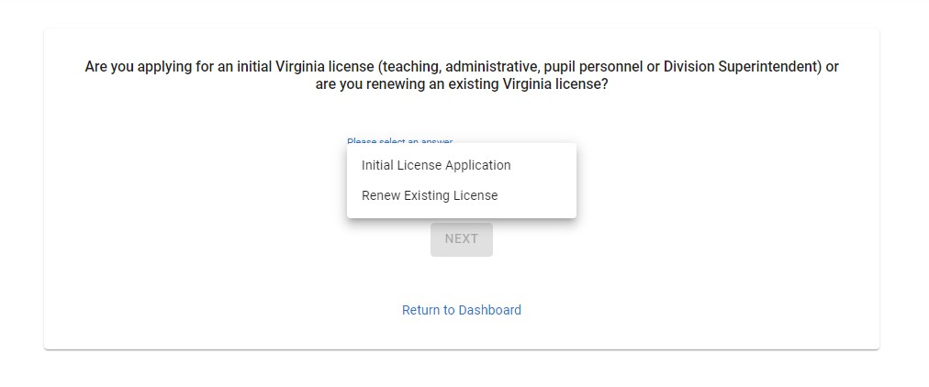
Click the drop down that says Initial License Application and click next

Slide 14
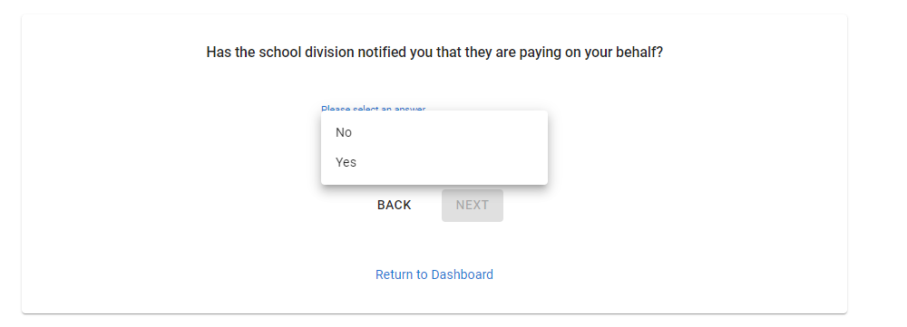
Click the drop down and select an answer.

Slide 15
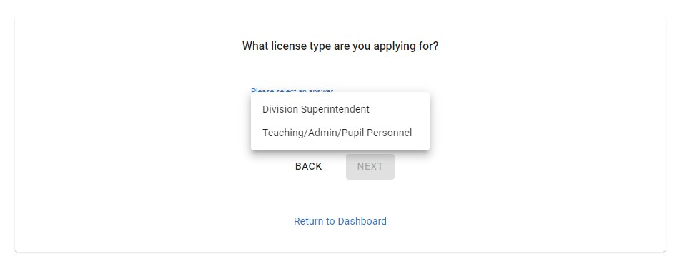
Select Teaching/Admin/Pupil Personnel from the drop down and click next

Slide 16
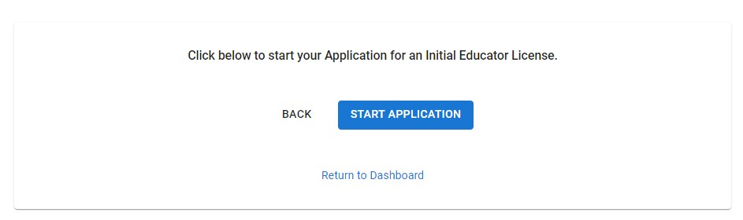
Click on Start Application

Slide 17
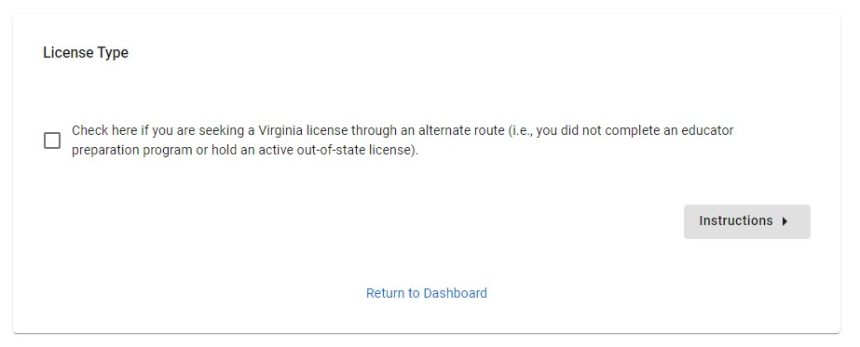
Do not click the check box
Click on instructions

Slide 18
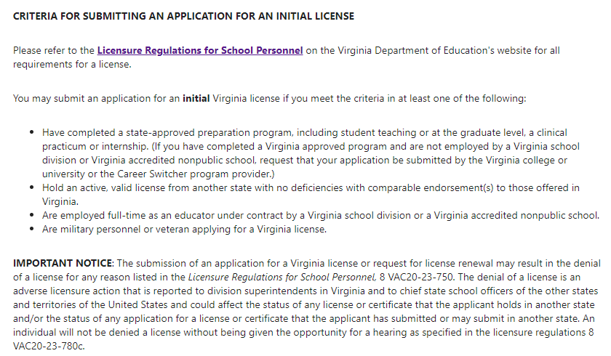
Read the instructions

Slide 19
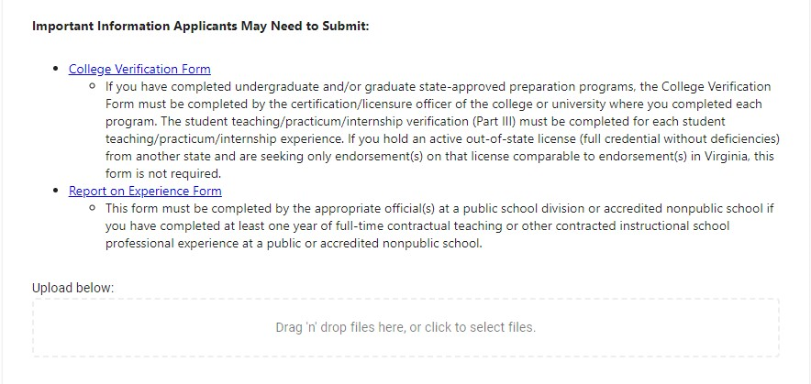
You will need to submit a College Verification Form
Please request your CVF from the GMU Licensure Coordinator
Upload the completed CVF you received from the Licensure Coordinator.

Slide 20
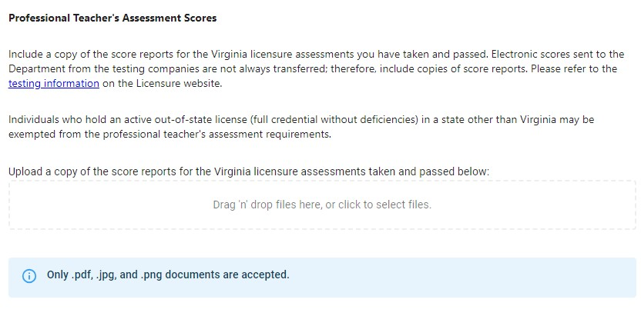
Upload all score reports required (i.e. Praxis II, Praxis Teaching Reading)
Upload score reports for all required exams – remember your scores must be reported to George Mason University

Slide 21
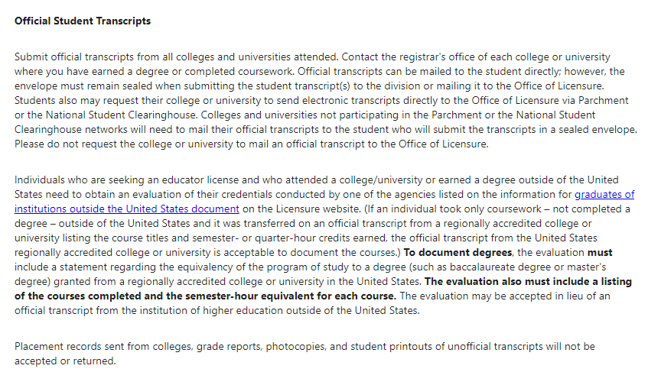

Submit ALL official transcripts to VDOE.
Remember to submit transcripts from all colleges attended.
PAY TO HAVE TRANSCRIPTS SENT TO THE VDOE. TRANSCRIPTS MUST BE REQUESTED USING PARCHMENT. INSTRUCTIONS CAN BE FOUND ON THE REGISTRAR’S WEBSITE OR PATRIOT WEB.

Slide 22
Official Transcripts
Order an official transcript for EACH university/institution you have attended
Visit this website to order official transcripts from GMU via Parchment
Ordering a transcript to be delivered electronically to VDOE is the preferred option as it is the fastest option.
Scanned copies of official transcripts will not be accepted
Opened envelopes containing paper official transcripts will not be accepted

Slide 23
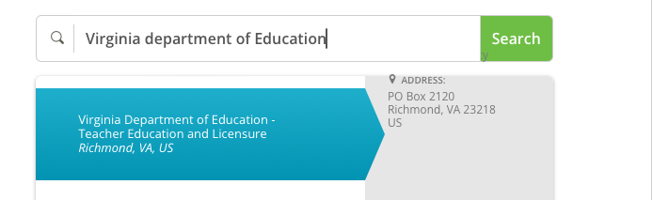
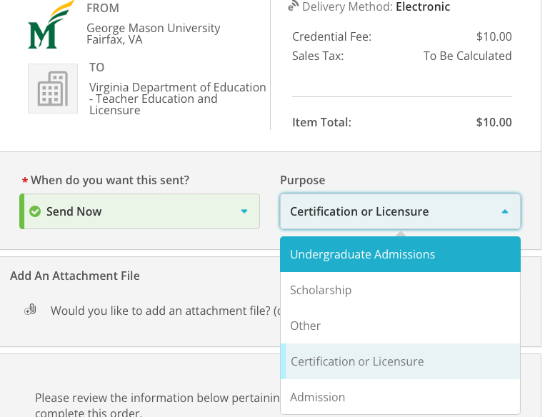
Send an electronic official transcript
Enter the recipient information
  Virginia Department of Education
Do not enter your information
Hit continue

Slide 24
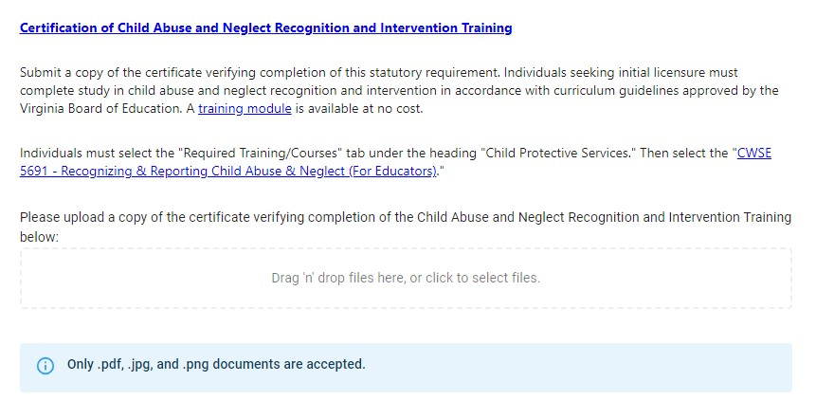
Skip Uploading Certification of Child Abuse and Neglect Recognition and Intervention Training

Slide 25
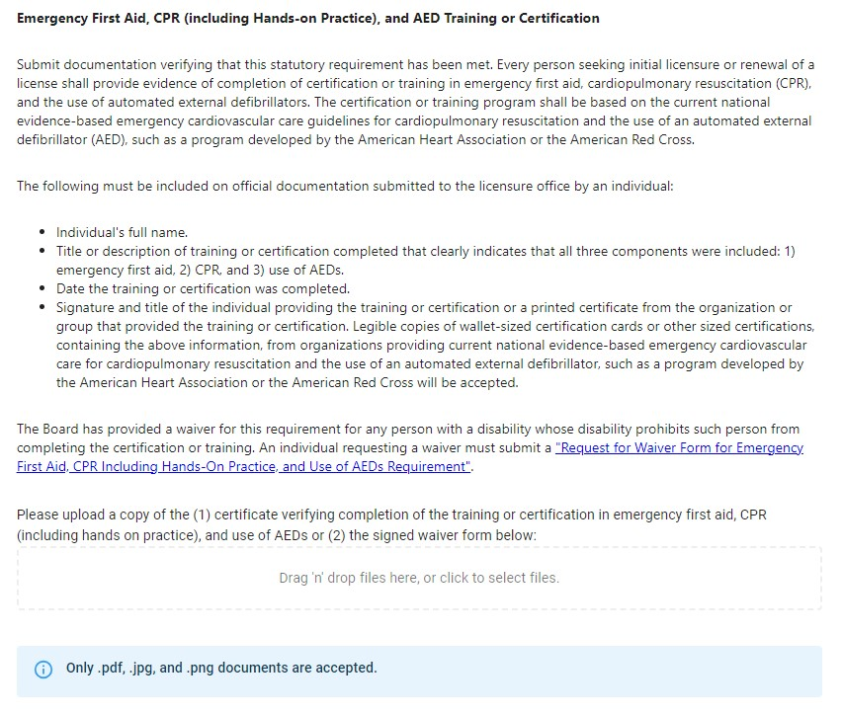
Skip uploading Emergency First Aid, CPR, and AED Training or Certification

Slide 26
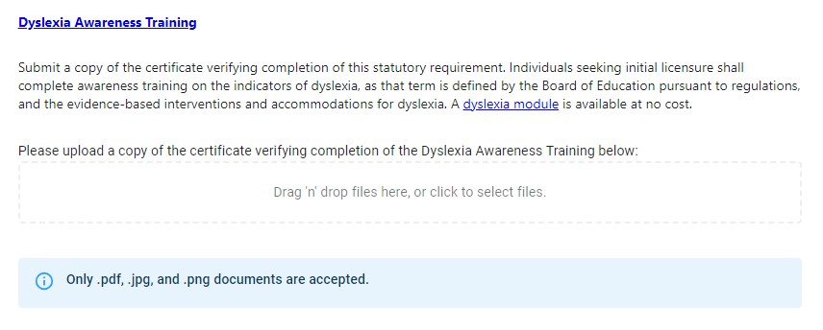
Skip uploading Dyslexia Awareness Training

Slide 27
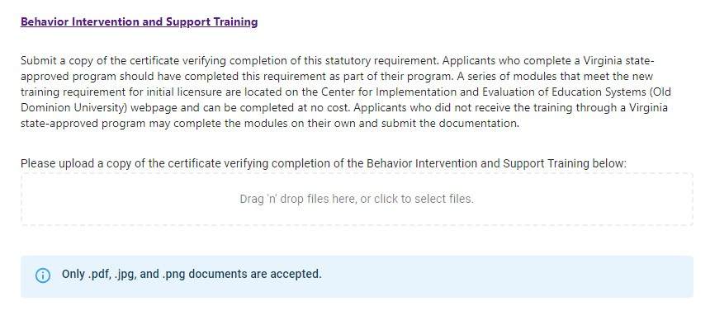
Skip uploading Behavior Intervention and Support Training

Slide 28
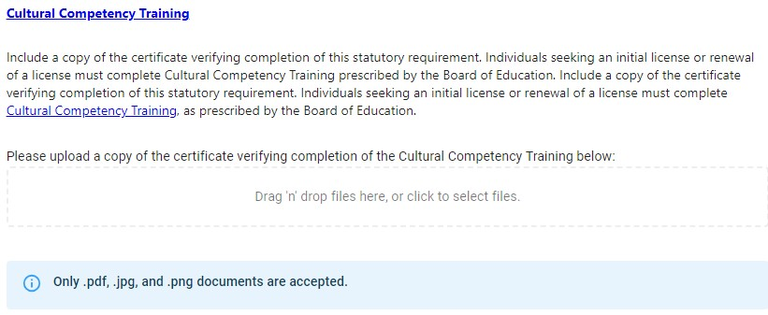
Skip uploading Cultural Competency Training

Slide 29
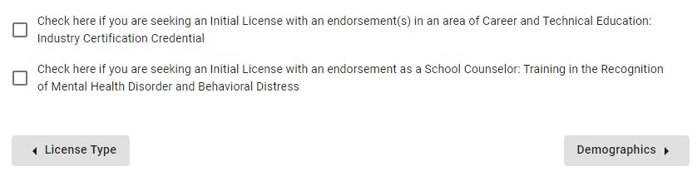
Do not click the check boxes and click Demographics

Slide 30
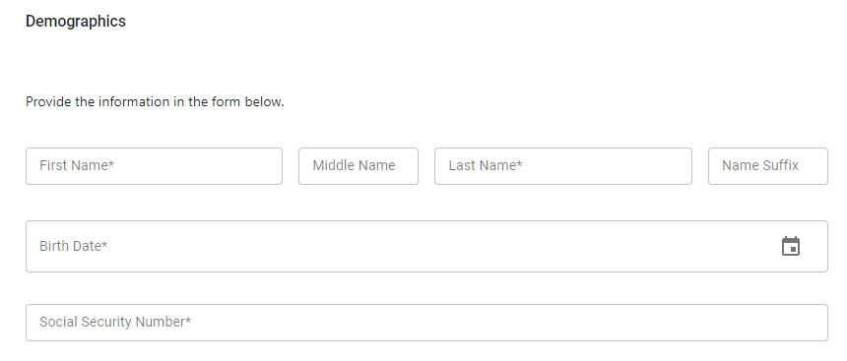
Fill in your demographic information

Slide 31
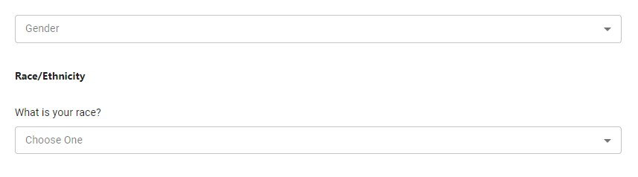
Fill in your demographic information

Slide 32
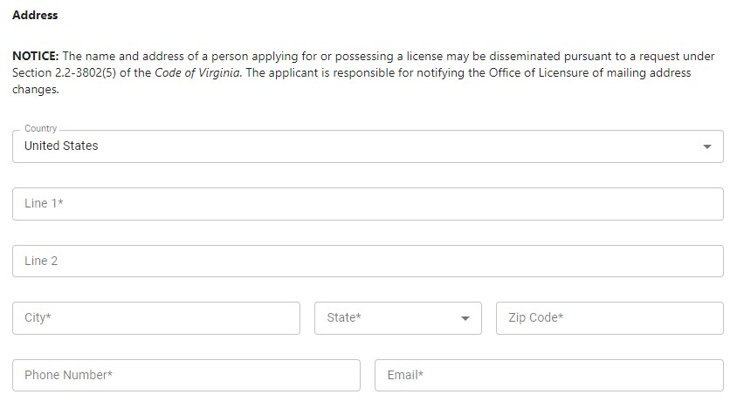
Fill in your address, phone number and email

Slide 33
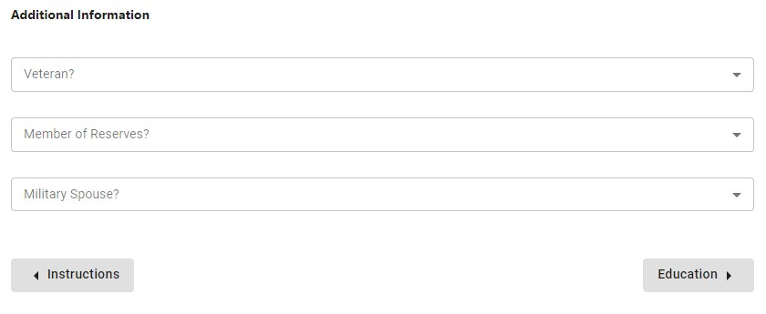
Answer the additional information questions and click education

Slide 34
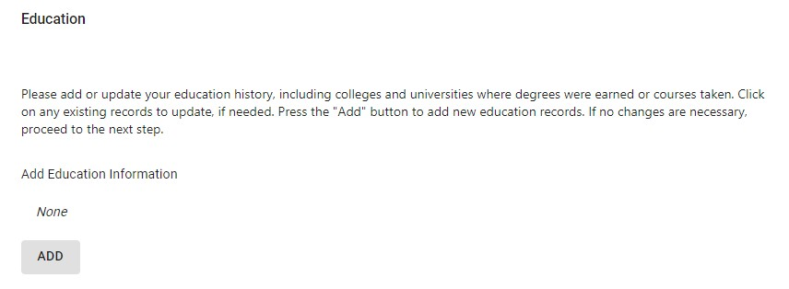
Click the ADD button and enter all colleges/universities you attended

Slide 35
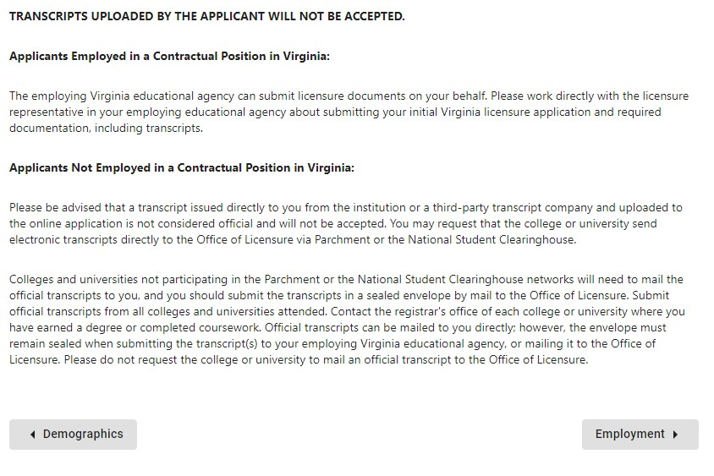
Click on Employment

Slide 36
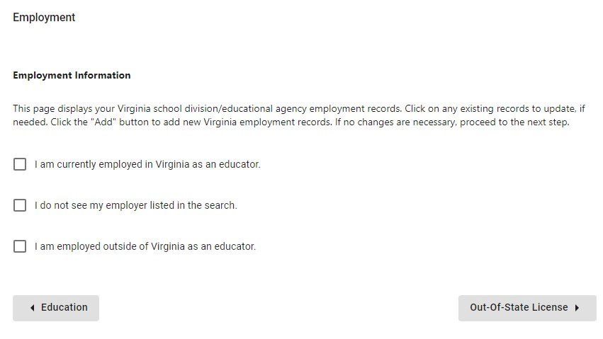
Select the box that applies to you
If none of the boxes apply to you, leave the boxes blank. Click the Out-Of-State License box to proceed to the next page. By clicking on the box, you are not saying you are out-of-state, you are proceeding to the next set of questions.

Slide 37
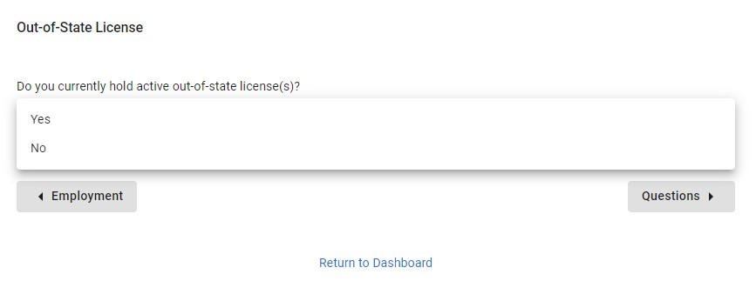
Indicate if you have an out of state license and click Questions

Slide 38
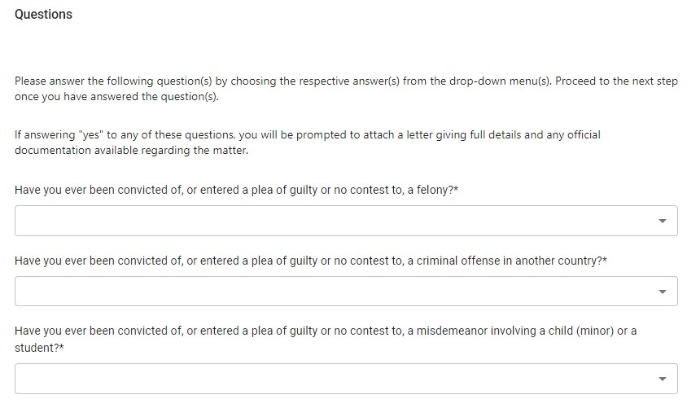
Answer all of the questions truthfully

Slide 39
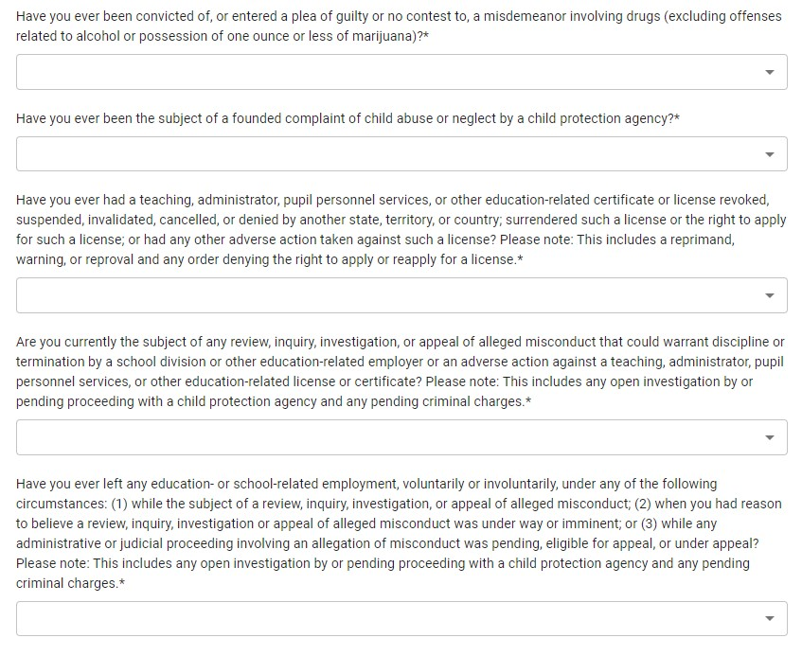
Answer all of the questions truthfully

Slide 40
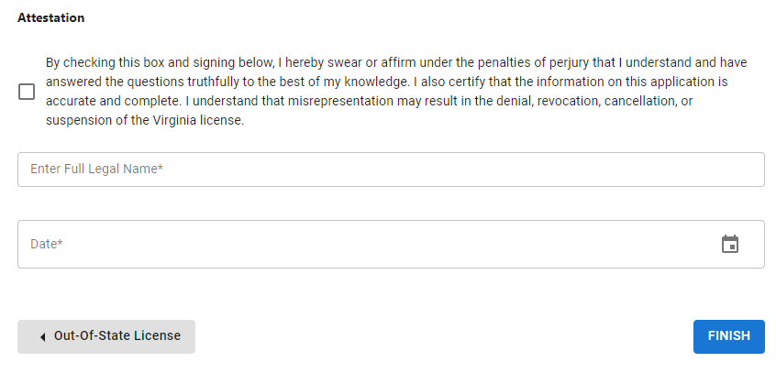
Check the box, sign your name, enter the date, and click FINISH

Slide 41
Summary Screen
You will be shown a summary screen. Please read through the information carefully for accuracy. If you do not agree with what you entered/found a mistake, click the “back” button to correct any issues. If you agree, proceed to the next slide in this presentation.

Slide 42
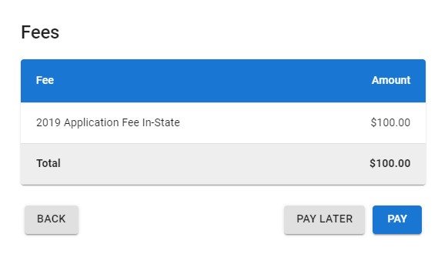
To pay the fee click on Pay
Your application will not be submitted until the payment is complete
The fee is $100 for in state residents and $150 for out of state residents

Slide 43
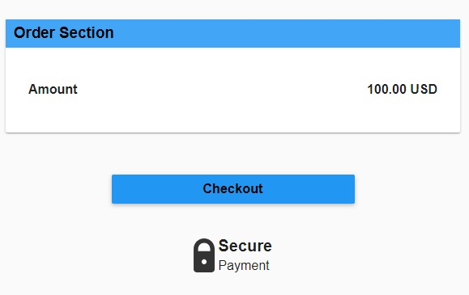
Click on Checkout

Slide 44
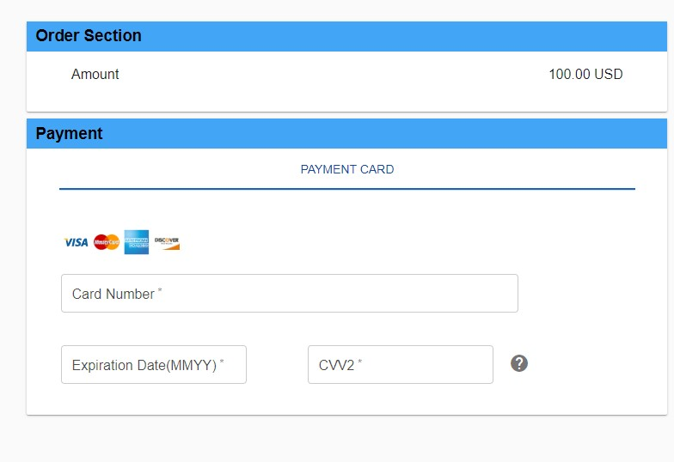
Enter your credit card information

Slide 45
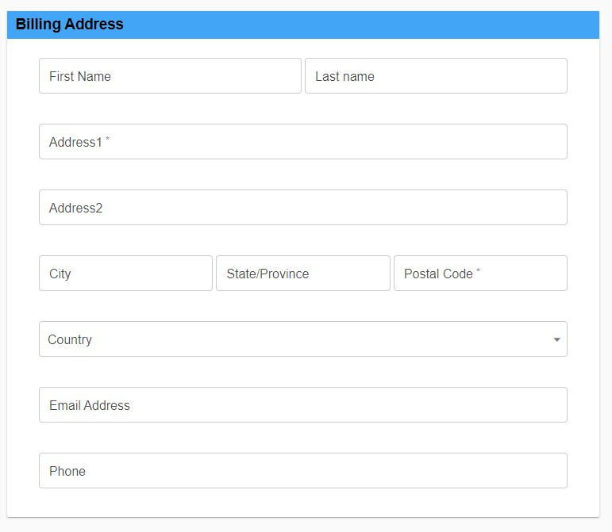
Enter your billing address, email, and phone number

Slide 46
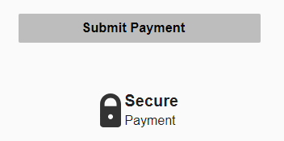
Click on Submit Payment – this will submit your application

Slide 47
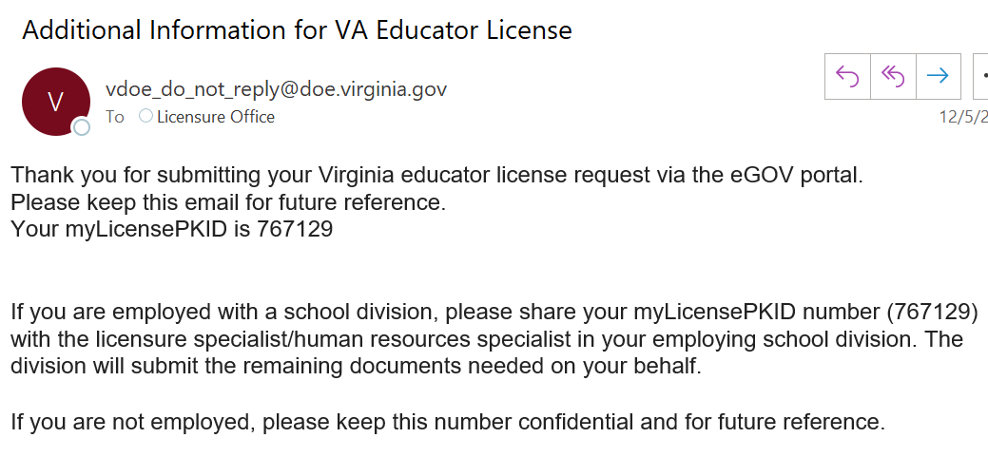
Once you submit your application you will receive an email with your myLicensePKID: please note, it can take up to 6-10 days to receive this email.
THIS NUMER IS VERY IMPORTANT – SAVE THIS EMAIL FOR YOUR RECORDS

Slide 48
Once the Licensure Coordinator uploads your supporting documentation, the Virginia Department of Education will review your application. Please be patient as it can take a few months for VDOE to review your application and grant licensure.
Please monitor your account on vdoe.mylicenseone.com for any updates from VDOE.

