Slide 1
Student Instructions: Accessing, Submitting Work & Viewing Assessment Results in VIA/SLL
George Mason University Fall 2024

Slide 2
Contents
Getting Started
  Blackboard or Canvas (3)
  First Time Login (4)
  Your VIA/SLL Progress Page (5)
Submit Work
  How to Submit Work (6)
  Your Work has Been Submitted (10)
  Self-Assessment (11)
  Internship Surveys (14)
Results and Support
  Making Changes (15)
  View Results (16)
  VIA/SLL Support (17)

Slide 3
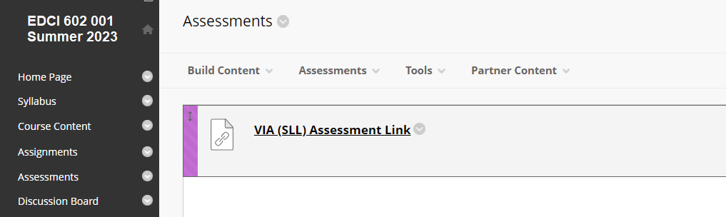
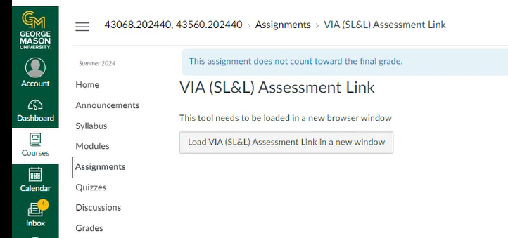
Blackboard or Canvas
You will login to VIA/SLL from the link, that your instructor will set up, on your Blackboard or Canvas course page. The functionality within VIA is the same regardless of whether you access it from Blackboard or Canvas.
“Single Sign On” means you do not need to enter a password. CLICK directly on the link to login.

Slide 4
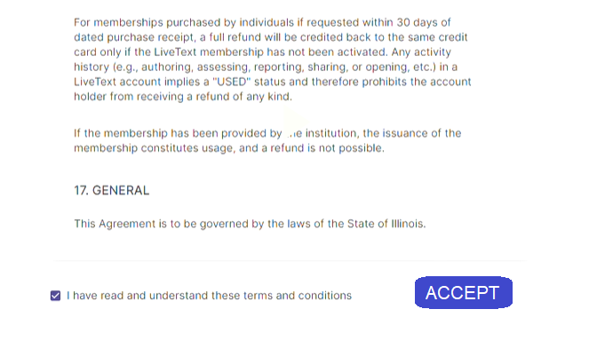
First Time Login
The first time you login you will need to agree to terms, please review these before agreeing.

Slide 5
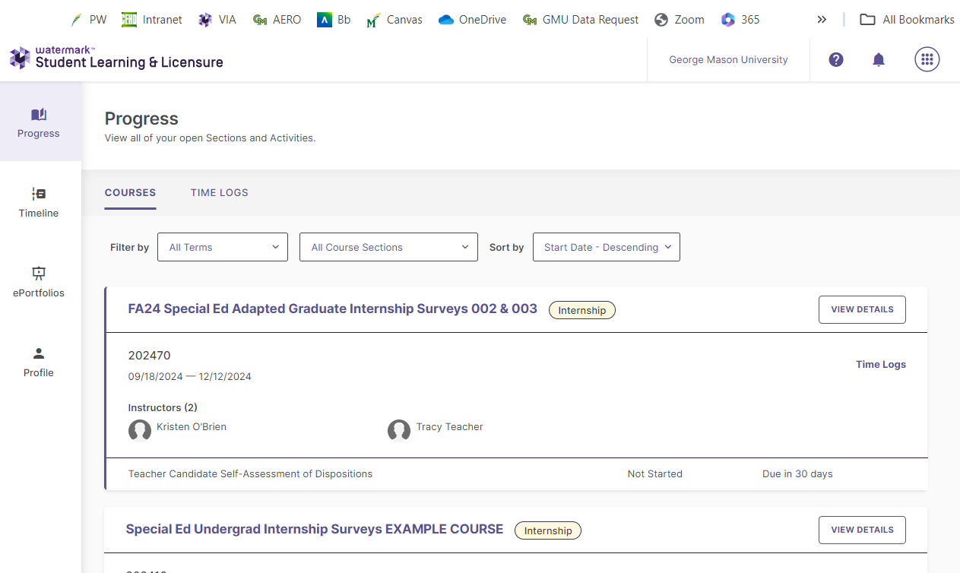
Your VIA/SLL Progress Page
Each time you click on an access link you will be brought to your Progress Page in VIA/SLL. Here you will see a list of courses you are currently enrolled in, as well as those from previous semesters.

Slide 6
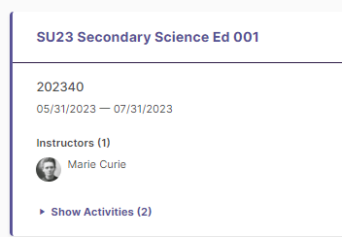
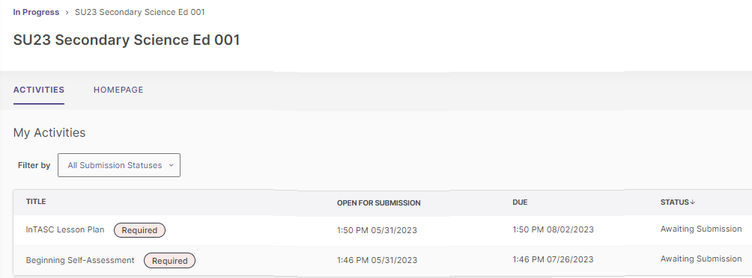
Submit Work (1)
First, CLICK on a course.
Then, CLICK on an assessment.

Slide 7
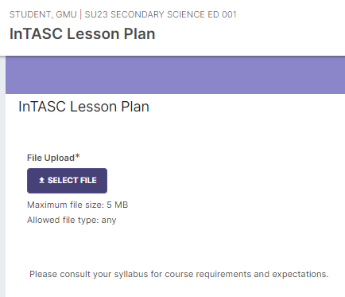
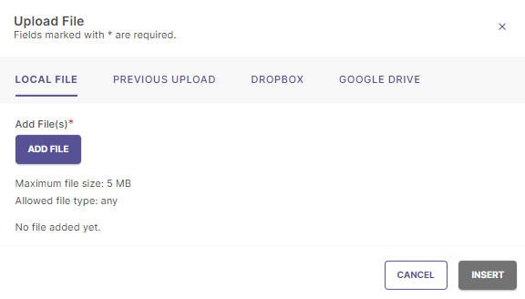
Submit Work (2)
CLICK on “Select File.”
CLICK on “Add File.”
*Upload is optional for the InTASC Lesson Planning and InTASC Internship assessments; please consult your syllabus for program specific submission and grading guidelines.

Slide 8
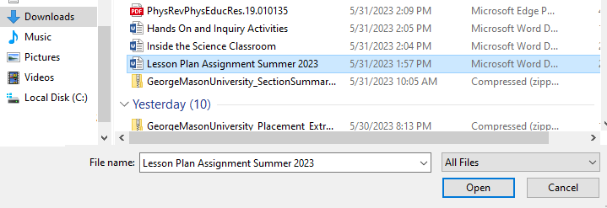
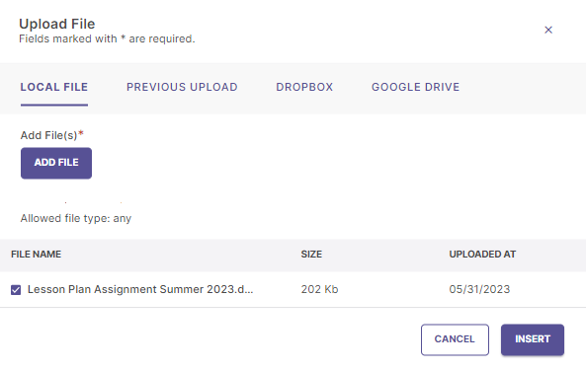
Submit Work (3)
Select a file (you may repeat to add additional files), CLICK “Insert.”

Slide 9
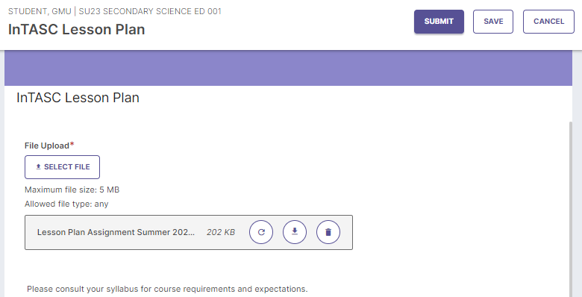
Submit Work (4)
CLICK “Submit.”

Slide 10
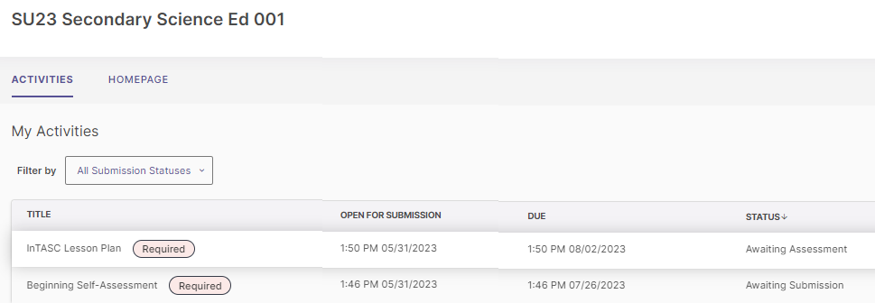
Your Work has Been Submitted
Your instructor can now score your work, no further action is required on your part.

Slide 11
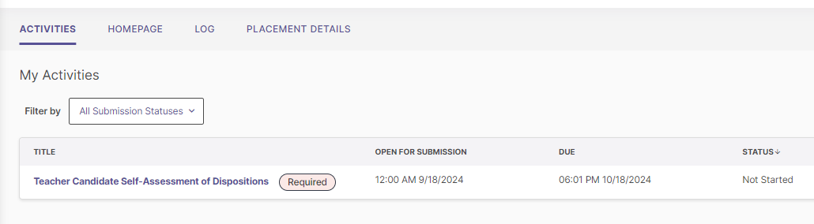
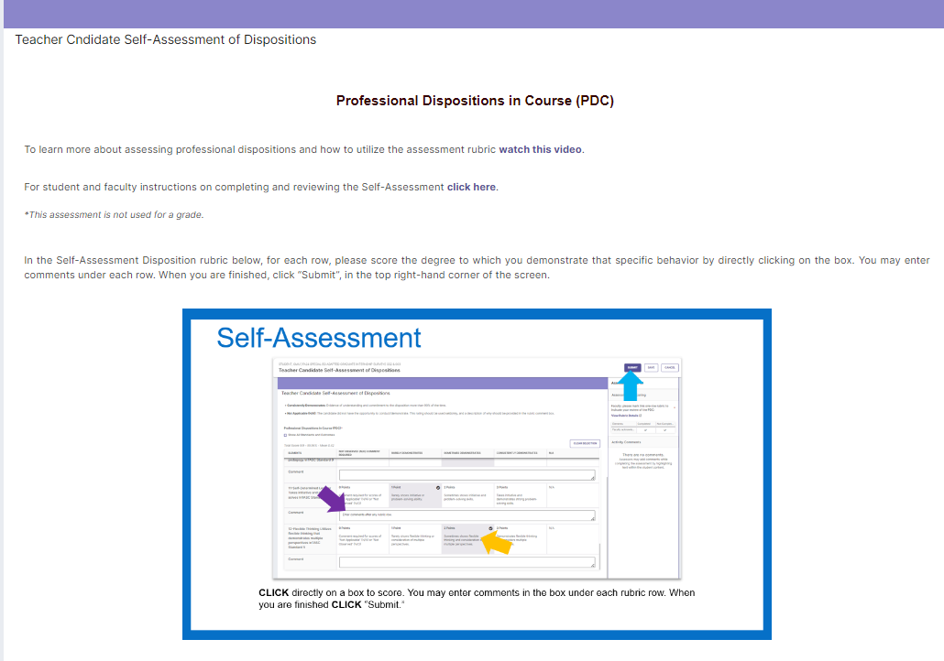
Self-Assessment
If you are enrolled in an Initial Licensure Program you may be asked to complete a Self-Assessment of Dispositions. You will access this assessment the same way as the course-based assessments outlined on the previous slides.
Please review the instructions before scoring the assessment rubric.

Slide 12
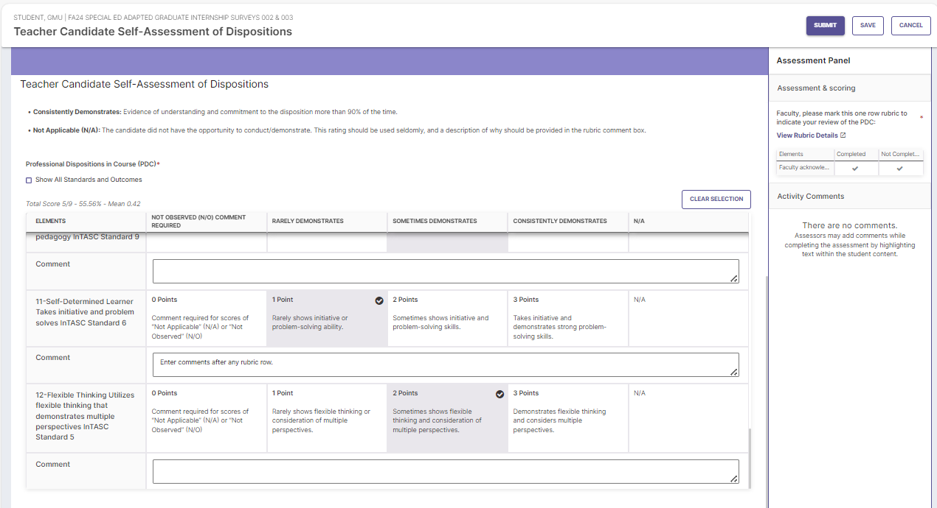
Self-Assessment
CLICK directly on a box to score. You may enter comments in the box under each rubric row. When you are finished CLICK “Submit.”

Slide 13
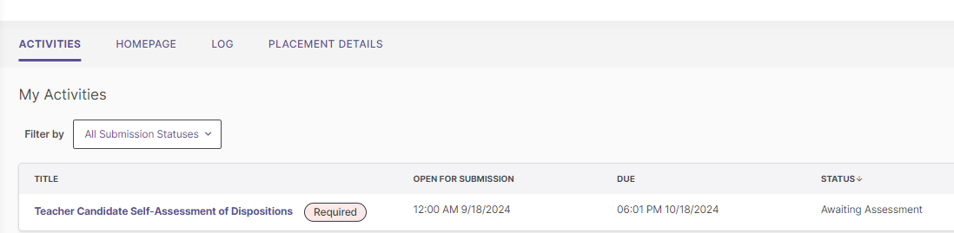
Self-Assessment
Once you have submitted your Self-Assessment rubric, it will be ready for your instructor to review. Your instructor will review your submission and mark it “Completed,” they may choose to provide feedback as well.

Slide 14
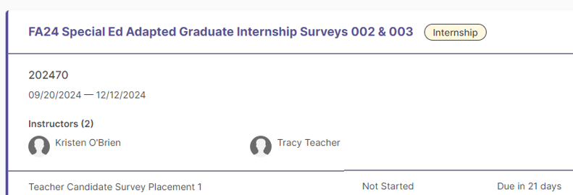
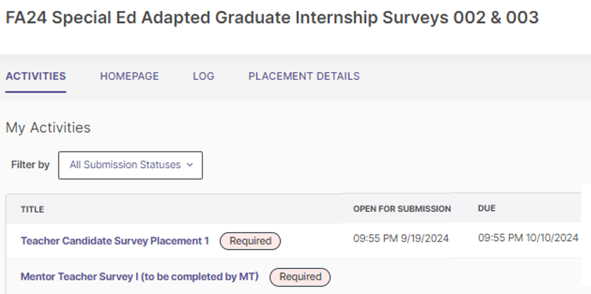
Internship Surveys
Students (Teacher Candidates) who are completing initial licensure internships, will be asked to provide feedback on their experience.
At the end of your placement, please login to VIA/SLL, locate the “Internship Surveys” course and complete the “Teacher Candidate” Survey. Instructions are provided, and the process is similar to completing the Self-Assessment (slides 11-13). Please complete a separate Internship Survey for each placement that you complete.
*Internship surveys are confidential, only quantitative data and redacted feedback will be shared with your program.

Slide 15
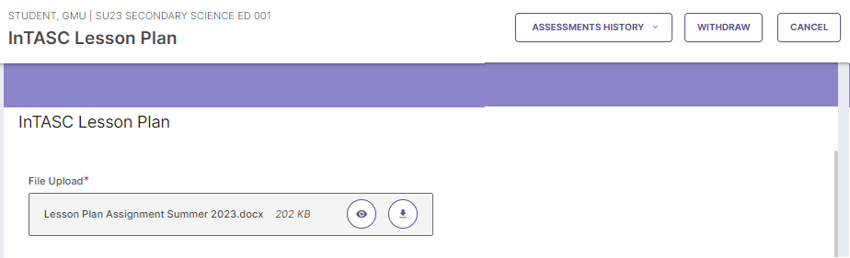
Making Changes
Need to make changes to your submission?
  If you have submitted but your work has not been assessed, you can use the “Withdraw” button.
  CLICK on the VIA link on your Blackboard or Canvas course page.
  CLICK on the course title.
  CLICK on the assessment title.
  Your submission will be visible on the left.
  At the top right CLICK on “Withdraw.” You can then delete your original submission and/or upload new/additional files.
*Once your work has been scored your instructor can allow you to make changes by selecting “Undo” and then “Request Revision” (slide 23, Faculty Instructions).

Slide 16
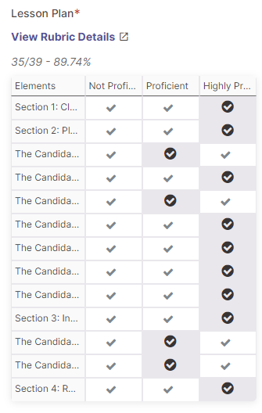
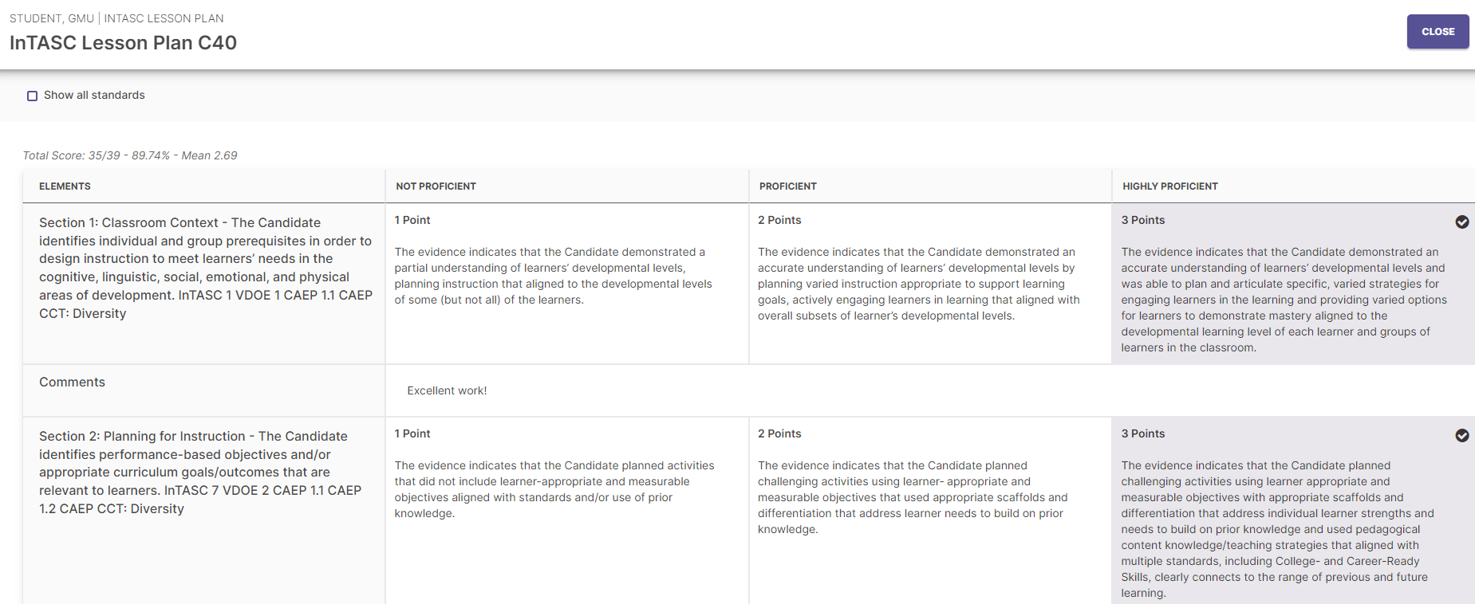
View Results
You can view the results after your instructor has scored your assessment. Simply follow the same steps:
CLICK on the VIA link on your Blackboard course page.
CLICK on the course title.
CLICK on the assessment title.
The rubric will be visible on the right.
View the full rubric by CLICKING on “View Rubric Details.”

Slide 17
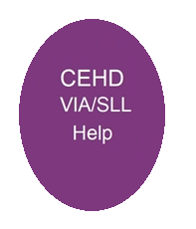
VIA/SLL Support
Have questions? Need help? Email viahelp@gmu.edu
  Please include your name, the course and section number and a brief description of your problem/question.
  All messages must be sent from your George Mason email account.
  Support messages will be answered in the order received, during business hours Monday-Friday.
  Instructions for students and faculty, as well as other useful information are available on the AERO Assessment webpage: https://cehd.gmu.edu/aero/assessments/.

