Slide 1
Faculty Instructions: Accessing, Reviewing and Scoring Course Based Assessments in VIA/SLL
George Mason University Fall 2024

Slide 2
Contents
Accessing VIA/SLL Courses
VIA/SLL Course Based Assessments (3)
Creating a Link-Blackboard or Canvas (5)
Your VIA In Progress Page (6)
Filter & Sort (8)
The Course (9)
Viewing & Scoring Assessments
The Assessment (10)
Assessment Status (11)
Force Submit (12)
View or Download Student Work (14)
Scoring the Rubric (15)
Assessment Panel (16)
Rubric Details (17)
Submit Score (18)
Scoring Complete (19)
Revisions, Reports & Support
Initial Licensure Programs-CAs & Surveys (20)
Initial Licensure Programs-Self-Assessments (21)
Undo (22)
Request Revision (23)
View Results (24)
Edit Due Date (26)
VIA/SLL Support (27)

Slide 3
VIA/SLL Course Based Assessments
The Accreditation and External Reporting Office (AERO), began using VIA to collect course-based assessment data in 2019; currently, the majority of CEHD programs, including teacher licensure programs, collect student data using this platform.
What’s in a name?
Watermark, the parent company, renamed VIA, “Student Learning and Licensure” (SLL), in 2022. AERO continues to refer to our assessment system as VIA and to utilize viahelp@gmu.edu for support. Don’t let the name confuse you, VIA and SLL are one and the same.

Slide 4
VIA Course Based Assessments
AERO collects a variety of course based assessment data, for numerous programs throughout the College of Education and Human Development (CEHD).
Initial Licensure Programs
Counseling
All Other Programs
Key Performance Indicators (KPI)
Common Assessments
Program Specific Assessments

Slide 5
Creating a Link-Blackboard or Canvas
Access links for VIA can easily be set up in either Blackboard or Canvas.
Video instructions for each are available on our webpage, AERO Assessment.
Additionally, videos for using “Force Submit”, reviewing Teacher Candidate (student) Self-Assessments and scoring assessment rubrics are available, as well as videos for students on uploading work and completing self-assessments.
VIA is a separate system, whether you access it from Blackboard or Canvas, once you are in VIA, you are in VIA.
The functionality within VIA is the same, no matter which system, Blackboard or Canvas, you use for access.
Clicking on the access link, in either Blackboard or Canvas takes each user into their VIA account (faculty cannot access a student view in VIA, by clicking on “Student View” in Blackboard).
The single sign-on link gives you access using your Mason credentials, you will not need to enter a password to access VIA.
Blackboard
VIA
Canvas

Slide 6
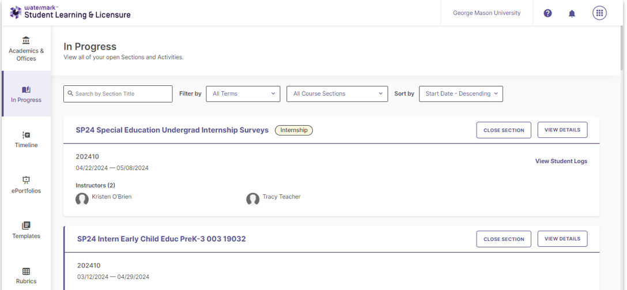
Your VIA In Progress Page
Each time you or your students click on the link you will be taken to your respective “In Progress” page in VIA; from here you can access all of your course based assessments.

Slide 7
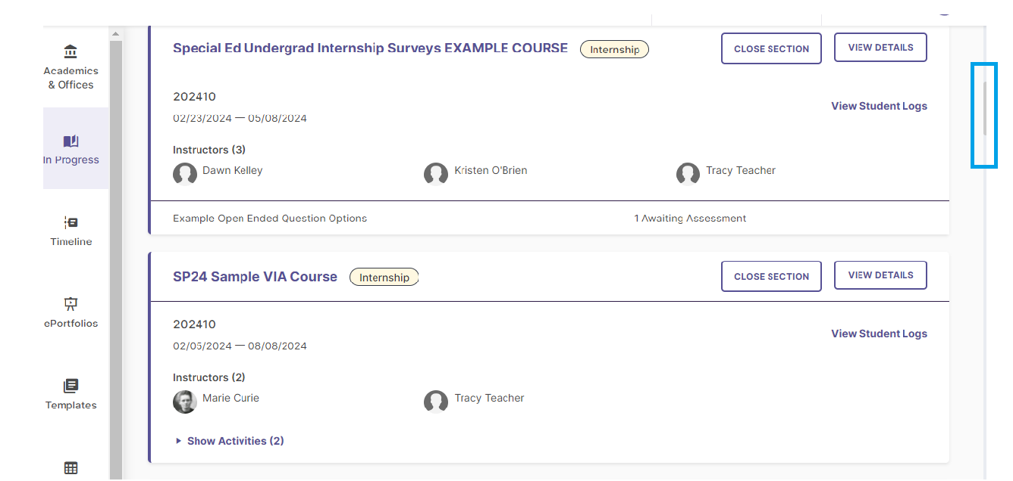
Your VIA In Progress Page
Courses from the current semester will appear near the top of your page, to view additional courses, including those from a previous semester, scroll down the page:

Slide 8
Filter & Sort
Dropdown menus at the top allow you to search by title (top left), filter by term or sort by start date or alphabetical order (top right). You can disregard the “All Course Sections” menu; it is not applicable.

Slide 9
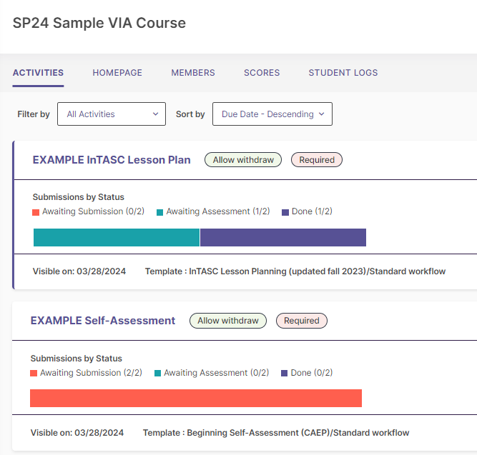
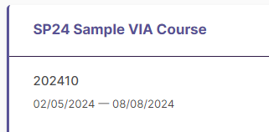
The Course
Once you have located the desired course, CLICK directly on the course name to view the associated assessments.

Slide 10
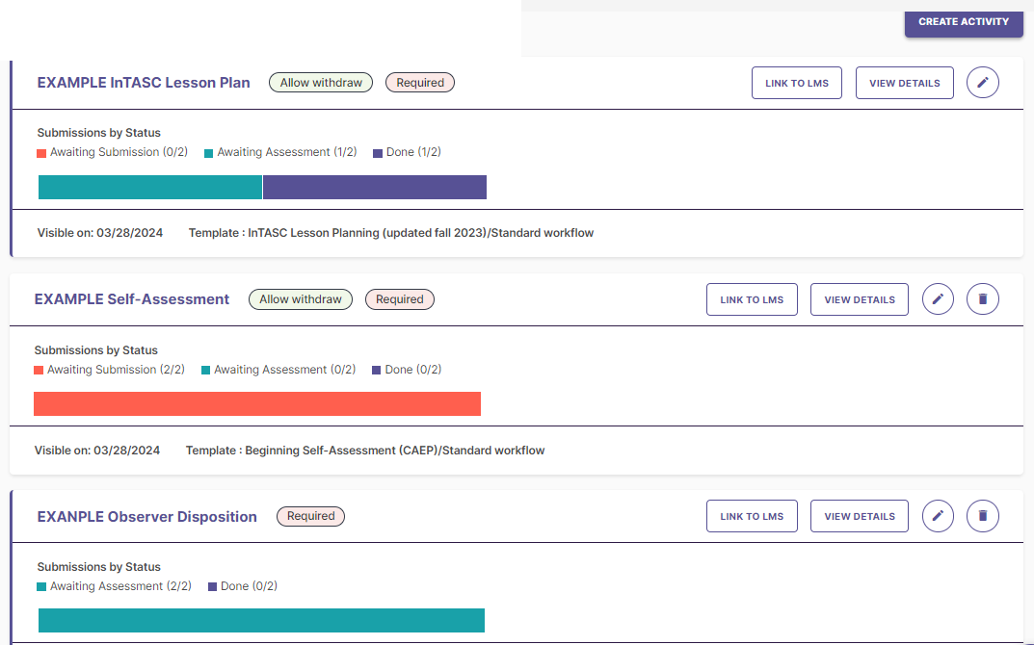
The Assessment
You will notice a “Create Activity” button on the top right, do not click on this; all of your assessments have been set up for you by AERO. There may be multiple assessments for a particular course, you may need to scroll down to view them all. CLICK directly on an assessment title to score the assessment.
Observational Workflow-This is currently ONLY APPLICABLE to a handful of specific rubrics, including the Professional Dispositions in the Field (PDF) in the initial teacher licensure courses. When AERO sets up a rubric with an Observational Workflow, there is no option for students to upload and you may score the assessment at any time

Slide 11
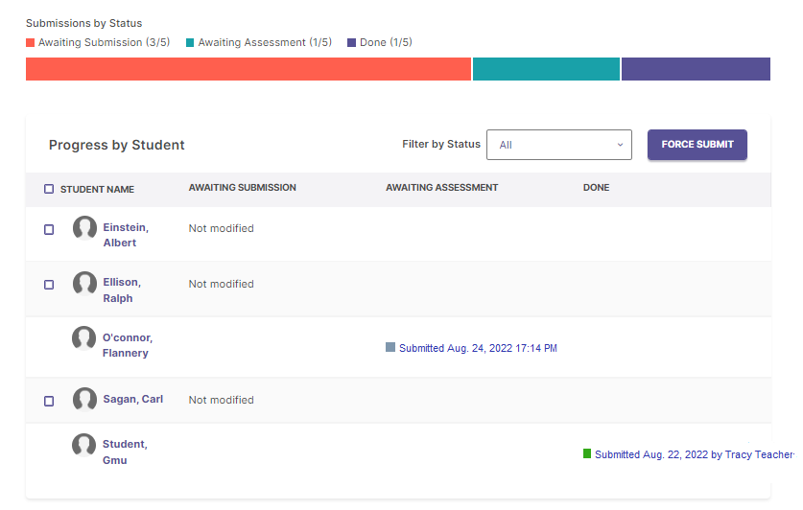
Assessment Status
Awaiting Submission
Student has not uploaded work. Student must submit work OR faculty must use Force Submit (slides 12-13) to change status to “Awaiting Assessment”.
Awaiting Assessment
Assessment can be scored.
Done
Assessment rubric has been scored. To make changes or allow a student to resubmit, see slides 20-21.
If a student’s status reads “Awaiting Assessment” you may score the rubric for this student. CLICK on the row, with the student’s name, to access the assessment rubric.

Slide 12
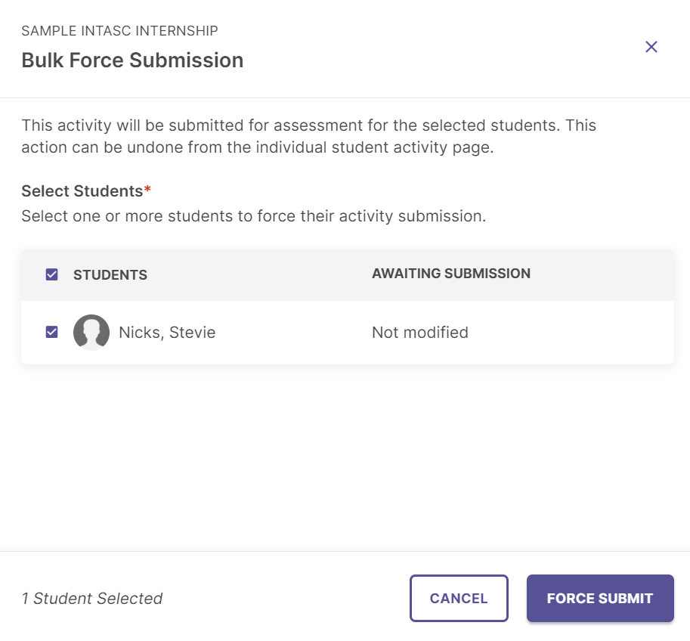
*Force Submit
If one or more students have not submitted, but you would like to assess them anyway, CLICK on “Bulk Actions”, then “Force Submission” and check the box next to each name (or CLICK the box at the top, next to the word students, to select all), then CLICK on “Force Submit.”
*If the student is already “Awaiting Assessment” proceed to slide 14.

Slide 13
Force Submit
Force Submit will move all selected students from “Awaiting Submission” to “Awaiting Assessment.”

Slide 14
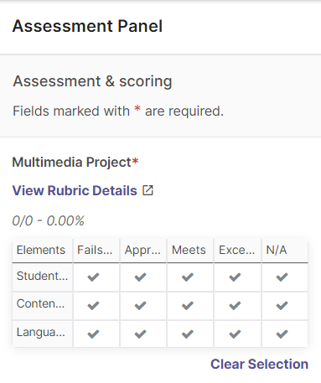
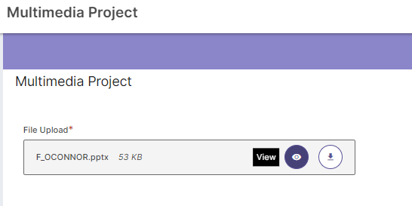
View or Download Student Work
Some assessments require/give the option for students to upload work; if work has been uploaded you will have the option to view the work in browser or download, before scoring the rubric. To view work (if any) and score the rubric, take the following steps:
On the Left- Hover your mouse over the student submission and CLICK to view or download student work.
On the Right- The “Assessment Panel” displays a condensed version of the rubric.

Slide 15
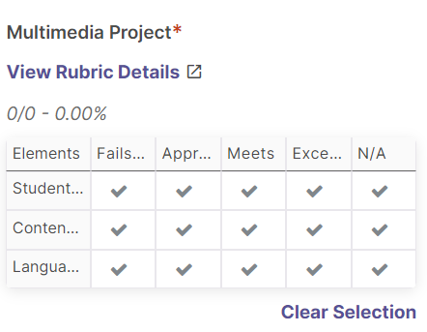
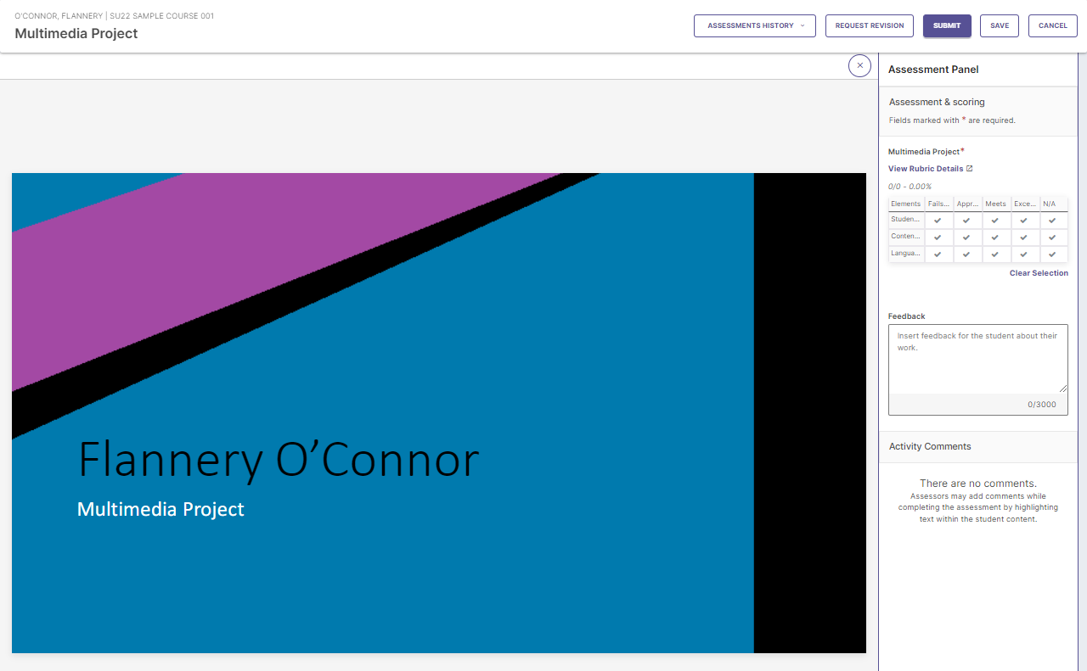
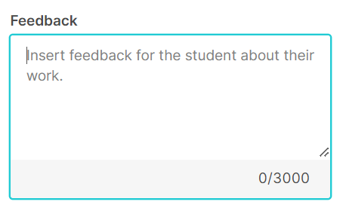
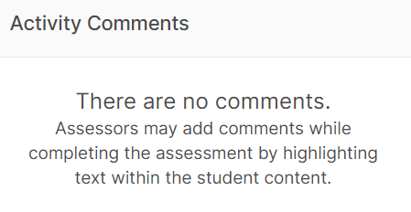
Scoring the Rubric
Once you have opened the student submission in VIA/SLL (as above) or downloaded the file(s), you are ready to score.
You may score directly on the condensed rubric provided or CLICK on “View Rubric Details” to score the full (detailed) version.
Please note “Feedback” is optional, you may leave this box blank if you choose.
“Activity Comments” is not applicable to scoring rubrics and should be disregarded.

Slide 16
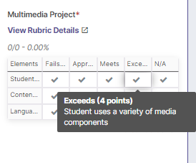
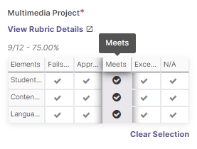
Assessment Panel
CLICK directly on a box to score OR
CLICK on the box at the top of the column to autofill the entire column.
View scoring criteria by hovering your mouse over the boxes.

Slide 17
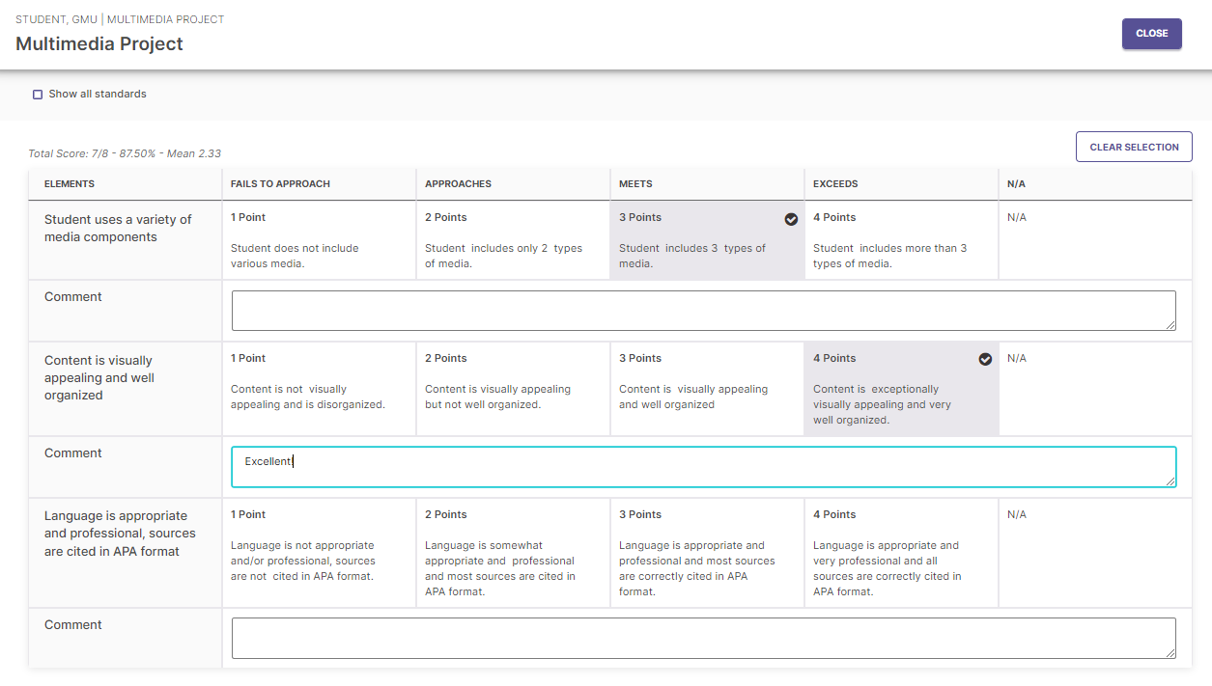
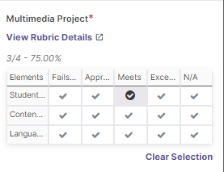
Rubric Details
CLICK on “View Rubric Details.”
On the Detailed Rubric, you may CLICK and type comments in the comment boxes under each row. These comments will be visible to students when they click on “View Rubric Details.” You may score by CLICKING directly on the boxes; to return to the student submission CLICK on “Close.”

Slide 18
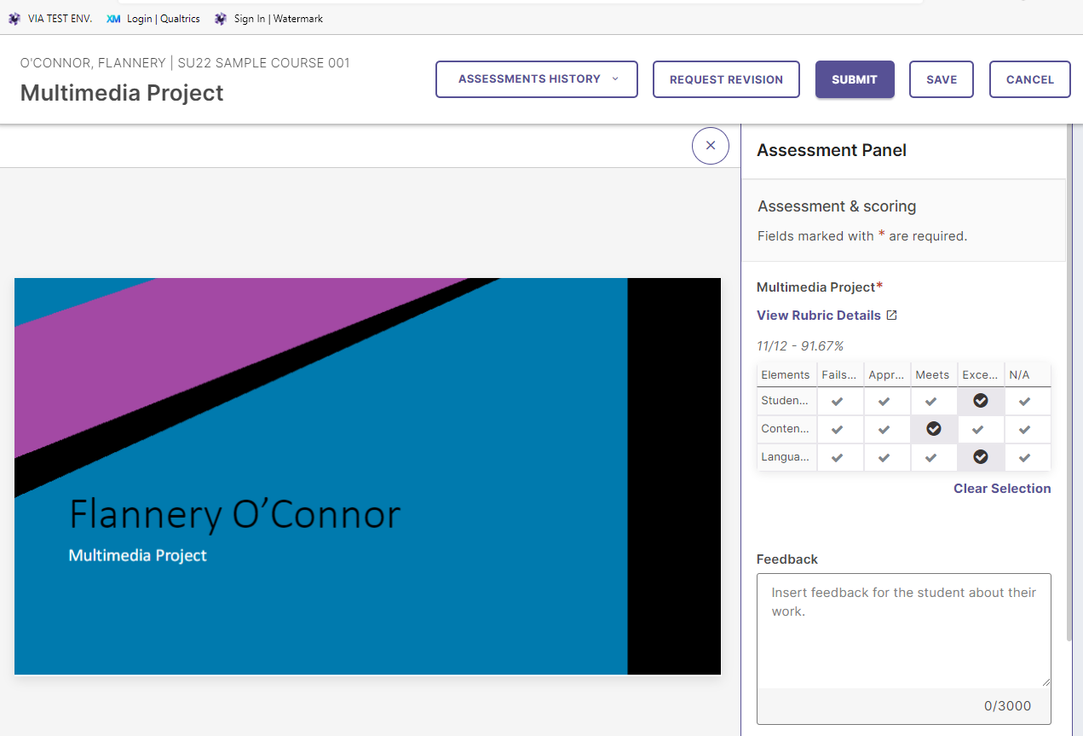
Submit Score
When you are done scoring CLICK “Submit.”

Slide 19
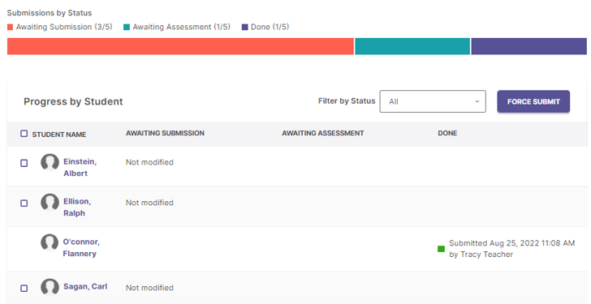
Scoring Complete
The assessment is completed as noted in the “Done” column; no further action is required.

Slide 20
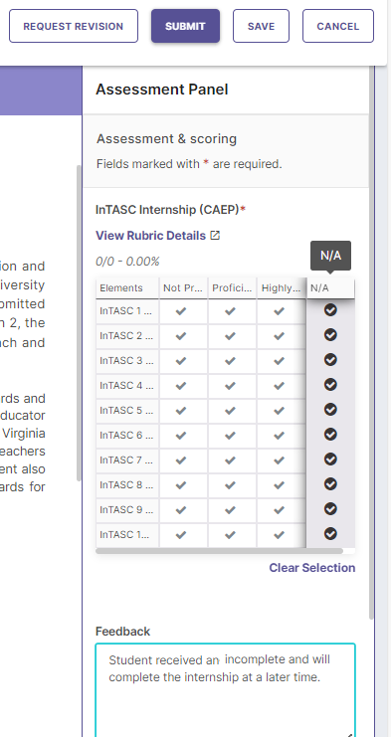
Initial Licensure Programs-CAs & Surveys
Initial Licensure programs collect Common Assessment (CA) data through the InTASC Internship, Lesson Plan, Professional Dispositions in Course (PDC) and Professional Dispositions in Field (PDF). Each CA rubric should be completed for each student.
If a student does not complete the assessment a score of “N/A” should be entered and an explanatory comment should be added. If the student did complete the requirements for the assessment but did not upload work in VIA/SLL the “Force Submit” feature can be utilized (slides 12-13).
Internship Surveys, previously collected in Qualtrics, all Internship Surveys will be collected in VIA/SLL as of fall 2024.
Teacher candidates (students) will complete surveys about their internship experience; these data are confidential and only quantitative data and redacted qualitative feedback will be shared with the program. Instructions are available on slide 13, Student Instructions.
Mentor Teachers will receive an email notification with a link to a survey in VIA.
University Supervisors will complete their review of the Mentor Teacher through a survey which is available in the VIA internship course (collected data are not visible to Teacher Candidates).

Slide 21
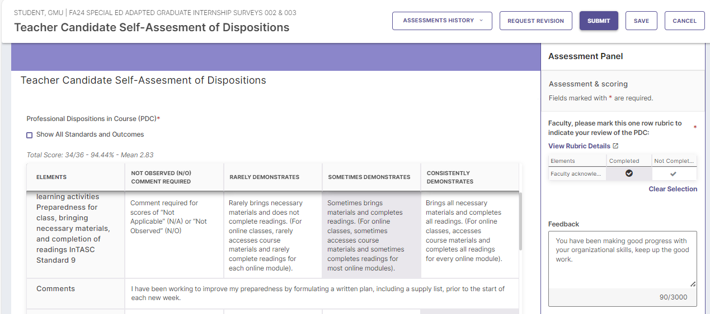
Initial Licensure Programs-Self-Assessment
Initial licensure program students (Teacher Candidates), will be required to evaluate their dispositions through the newly created “Professional Dispositions in Course (PDC)” tool (fall 2024). If you are teaching a course which contains this assessment, please remind your students to complete the rubric and be sure to review the results.
Faculty Review of Teacher Candidate Self-Assessments: Access the dispositional assessment as you would any other VIA/SLL assessment, then review the students’ responses and mark them “Completed”; additionally, you may add comments in the “Feedback” box. Video instructions are available: AERO Assessment.

Slide 22
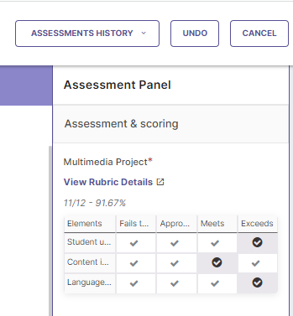
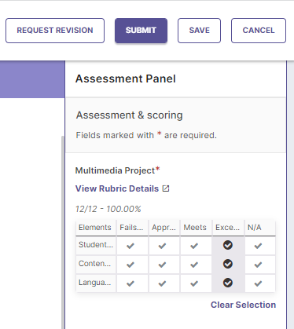
Undo
The rubric will retain the original scoring, but it is now editable; make any desired changes then CLICK “Submit.”
If you have completed scoring, but would like to make changes, access the student’s work as before (slides 14-15). Next CLICK “Undo” at the top right of the page.

Slide 23
Request Revision
To allow a student to resubmit, access their work as before (slides 14-15). Next CLICK “Request Revision” at the top right. The student can then delete the original submission and upload new files. NOTE: If you have already scored the assessment, you will need to CLICK “Undo” and then “Request Revision.”

Slide 24
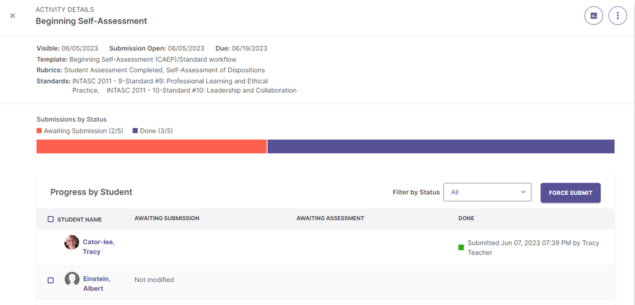
View Results
After you have scored the student assessments you may review results, CLICK on the assessment name, then from the student list view, CLICK on the graph icon at the top right.

Slide 25
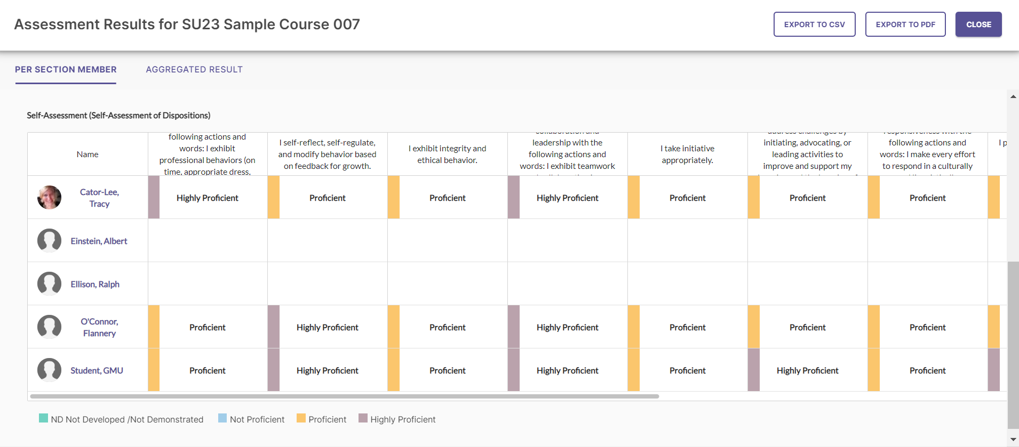
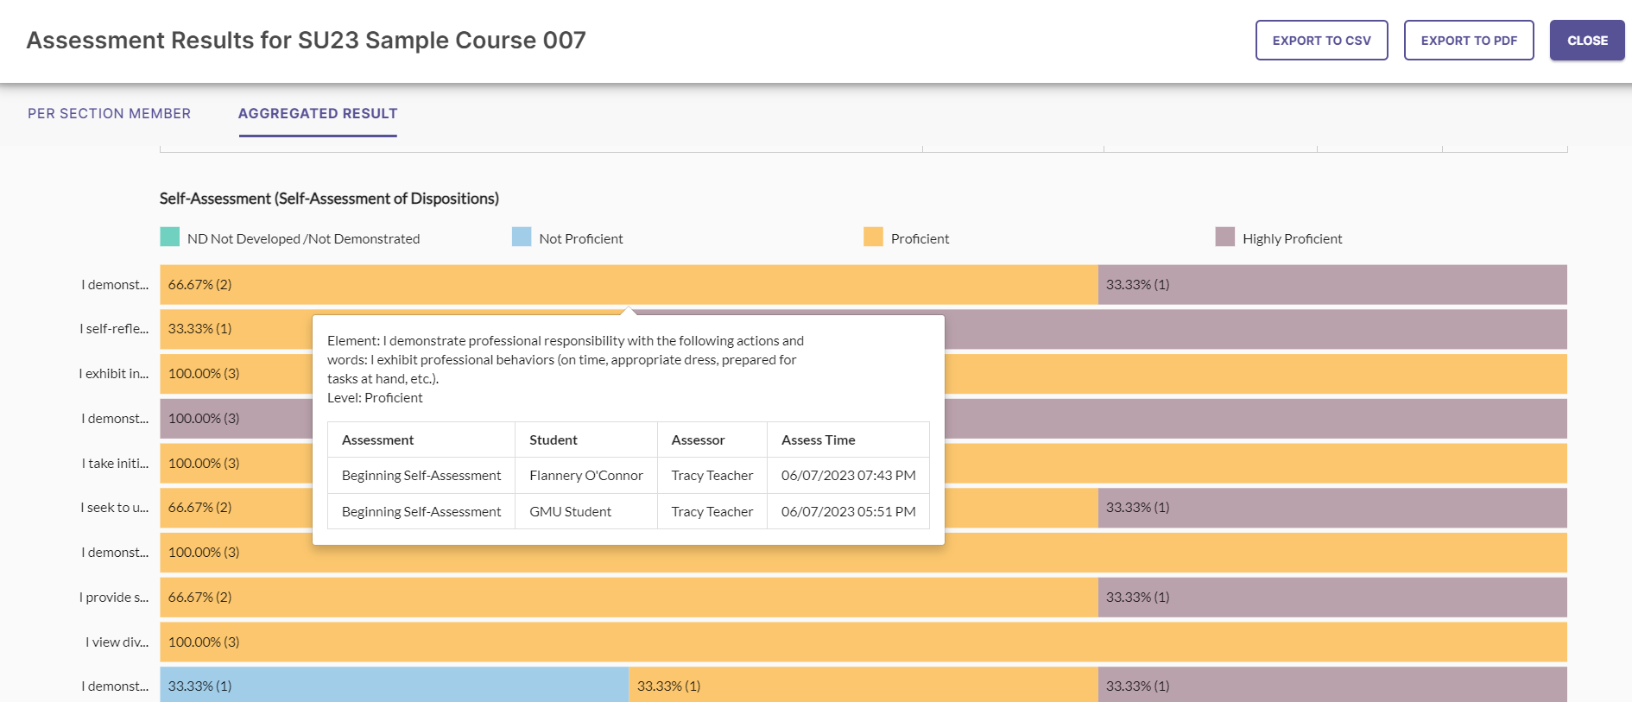
View Results
You will now see individual student results (you may need to scroll down to view all the data). You can also CLICK on “Aggregated Report”, this will display interactive graphs (you can CLICK on a graph to drill down). You can export either CSV or PDF versions of the data you are viewing. AERO will provide all programs with report data for accreditation and internal reporting, but you may view and download data for a specific course at any time.

Slide 26
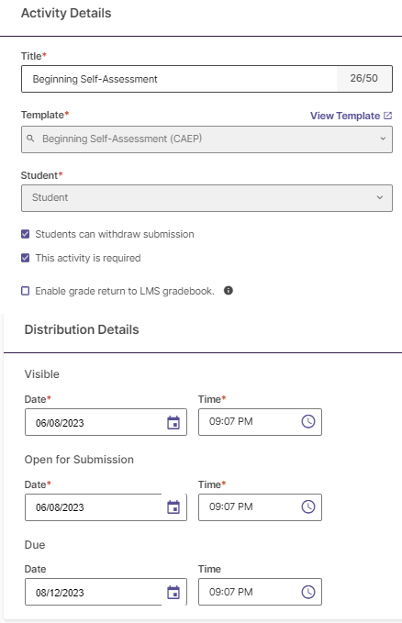
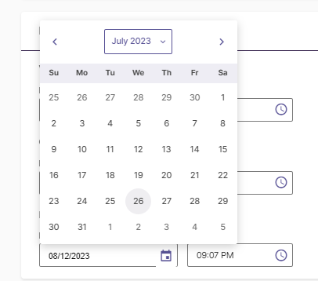
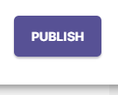
Edit Due Date
2
1
3
4
The Due Date for most assessments will be set as the last day of the course. If you would like to change the Due Date for an assessment, CLICK on the pencil icon at the top right, and scroll down. Under “Due Date” CLICK on the calendar icon and select a new Due Date, when you are done, CLICK “Publish” at the top right.

Slide 27
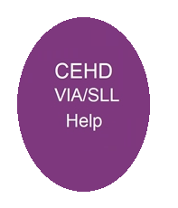
VIA/SLL Support
You will receive an email notification from AERO each semester with updates, information and a personalized list of the assessments you will be responsible for during the semester.
Please be sure to complete all assessments in a timely manner
Please email viahelp@gmu.edu anytime with your questions or concerns.
All messages must be sent from your George Mason email account.
Support messages will be answered in the order received, during business hours Monday-Friday.
Instructions for students and faculty, as well as other useful information are available on the AERO Assessment webpage: https://cehd.gmu.edu/aero/assessments/.

