Slide 1
Initial License Application Online Process using VALO
GMU Licensure Coordinator
Email Edlicen@gmu.edu with questions

Slide 2
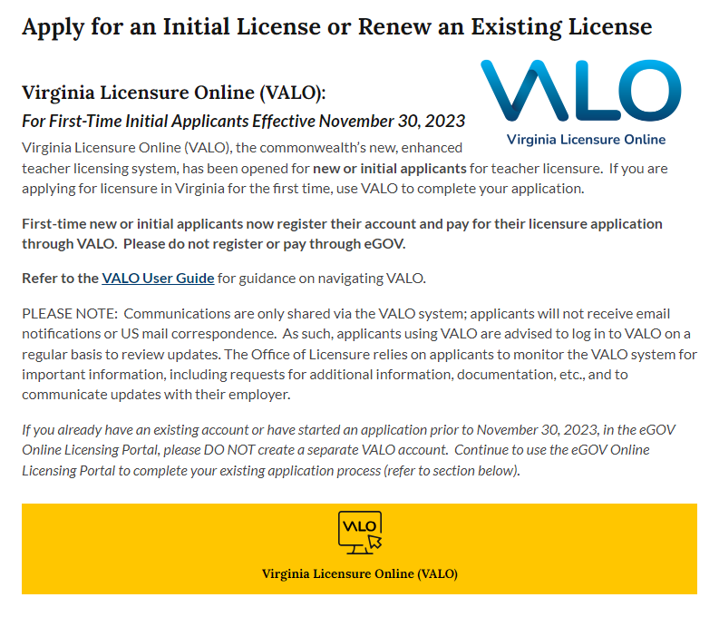
Part One – Access the VALO system
Visit the VDOE licensing services webpage
Click the yellow box that reads Virginia Licensure Online (VALO)

Slide 3
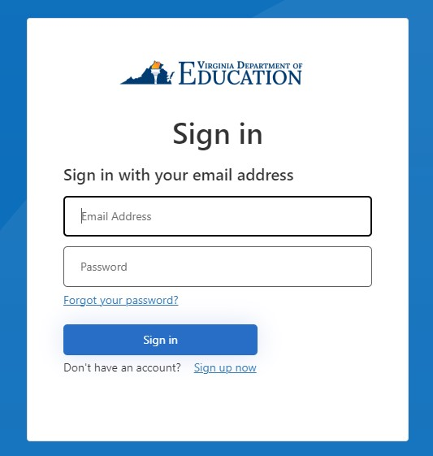
Create an account and sign in
Click sign up now

Slide 4
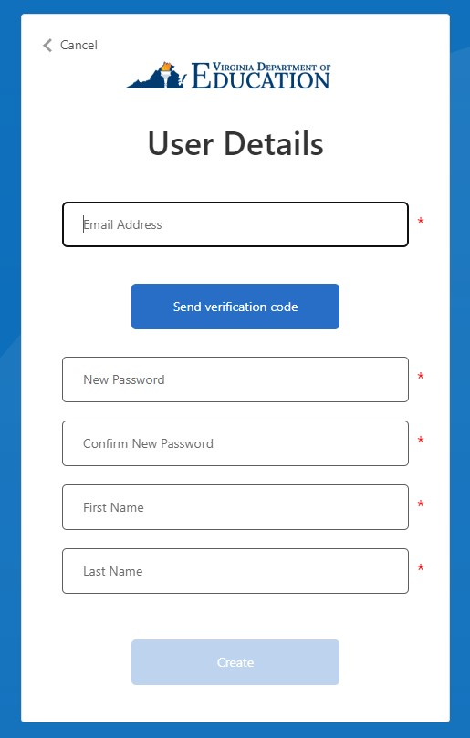
Create an account and sign in
Enter your email address
Click send verification code

Slide 5
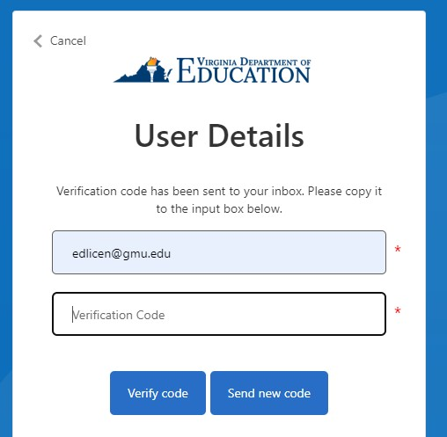
Create an account and sign in
Check your email for the verification code
Copy and paste the verification code in the box
Click verify code

Slide 6
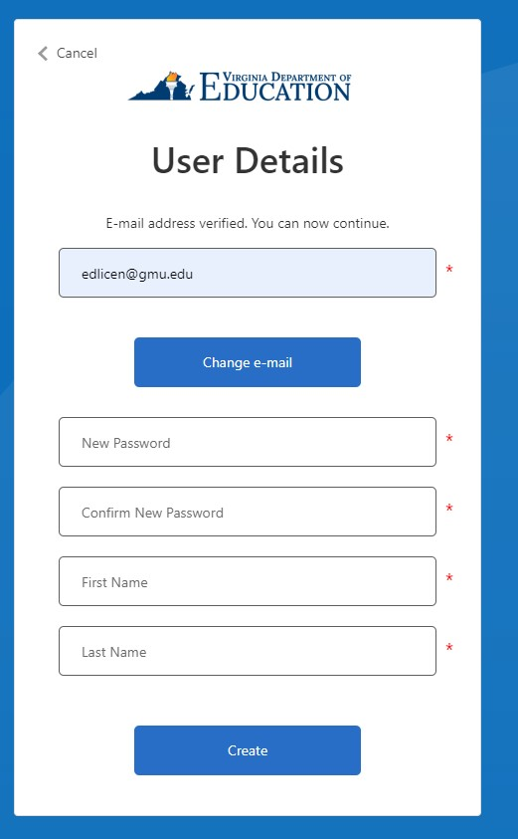
Create an account and sign in
Set your password
Enter your first and last name
Click create to make your account

Slide 7
Sign into your account
Enter your email and password
Click sign in

Slide 8
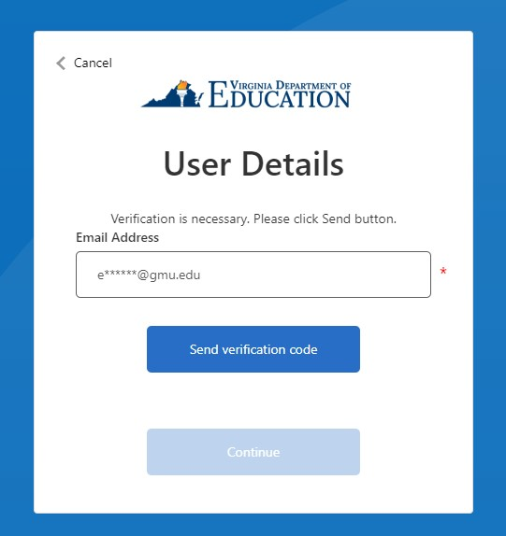
Sign into your account
Click send verification code
Enter verification code when prompted

Slide 9
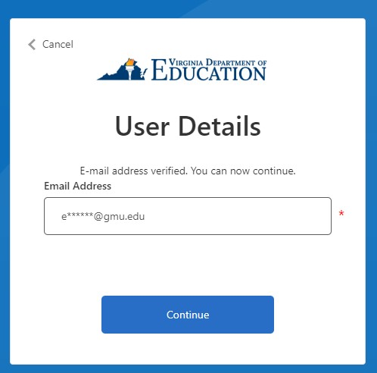
Verify email
Once you have entered the verification code click continue to access your account

Slide 10
Start your application In the top right corner you will see a box labeled Applying for a license Click the apply for a license box

Slide 11
Click the drop down that says Initial License Application and click next

Slide 12
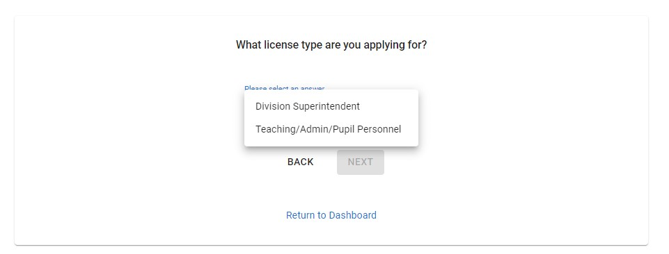
Select Teaching/Admin/Pupil Personnel from the drop down and click next

Slide 13
Click on Start Application

Slide 14
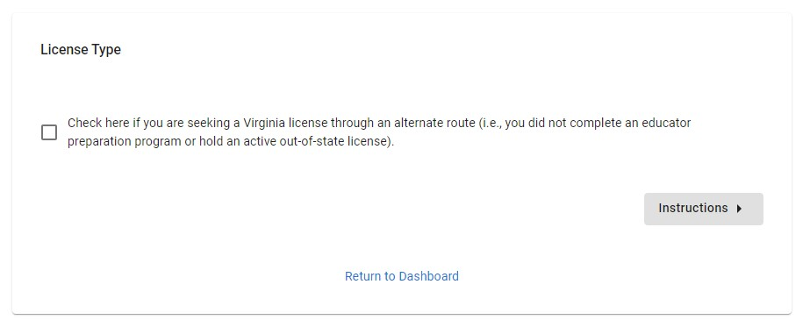
Do not click the check box Click on instructions

Slide 15
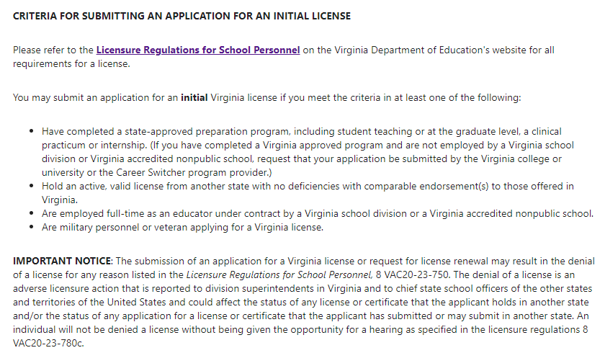
Read the instructions

Slide 16
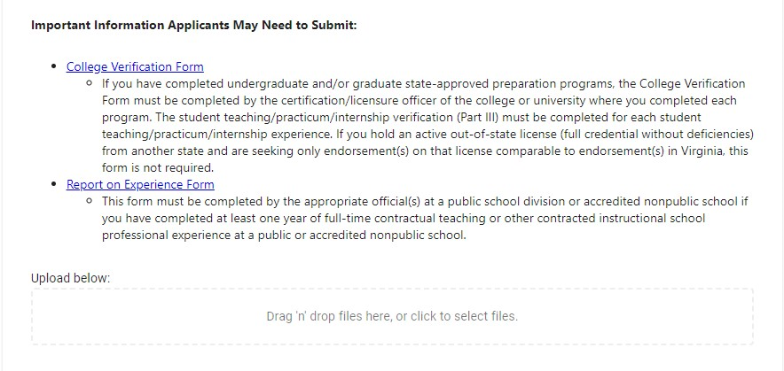
You do not need to submit a College Verification Form OR Report on Experience Form The GMU licensure coordinator will submit your CVF on your behalf
DO NOT SUBMIT ANYTHING HERE – SKIP THIS PART OF THE APPLICATION

Slide 17
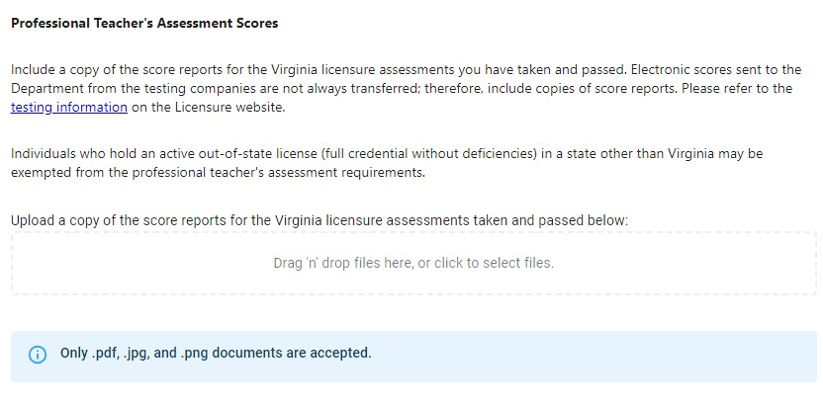
Upload all score reports required (i.e. VCLA, Praxis II, Praxis Teaching Reading)
Upload score reports for all required exams – remember your scores must be reported to George Mason University

Slide 18
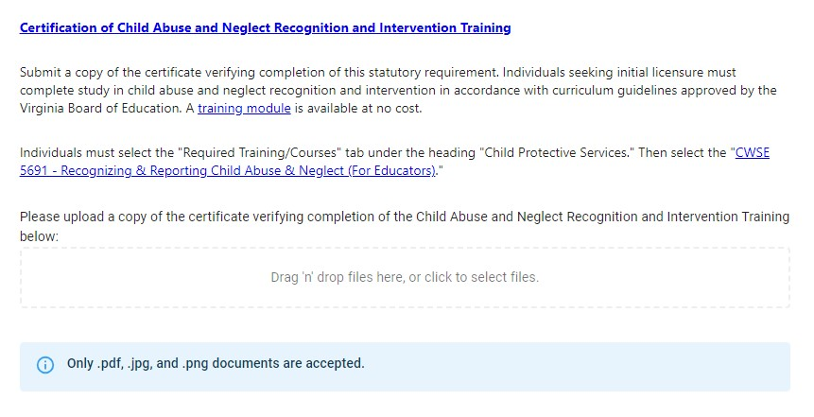
Skip uploading Certification of Child Abuse and Neglect Recognition and Intervention Training

Slide 19
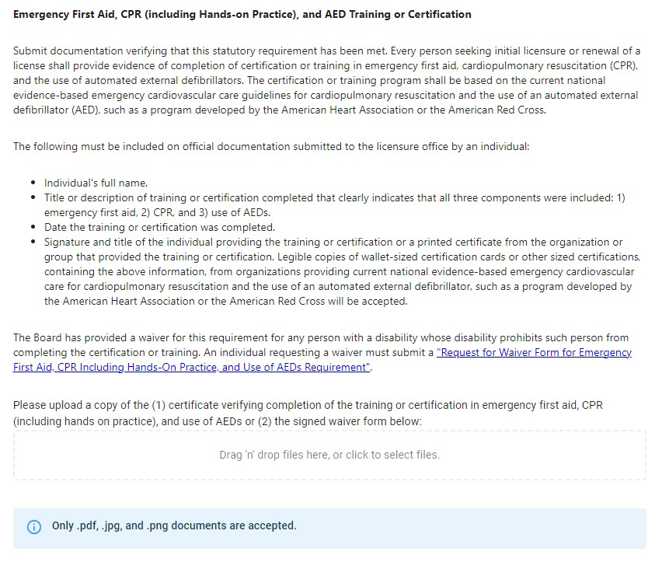
Skip uploading Emergency First Aid, CPR, and AED Training or Certification

Slide 20
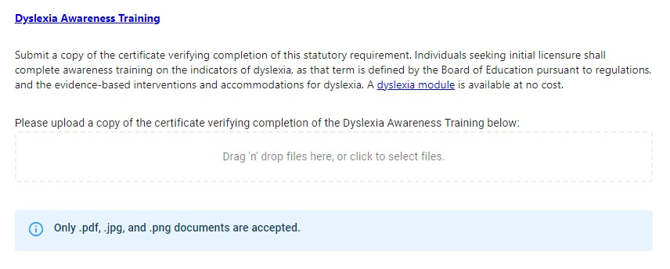
Skip uploading Dyslexia Awareness Training

Slide 21
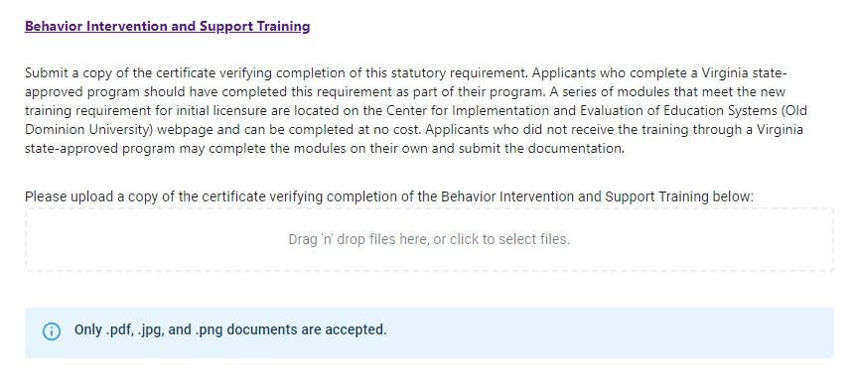
Skip uploading Behavior Intervention and Support Training

Slide 22
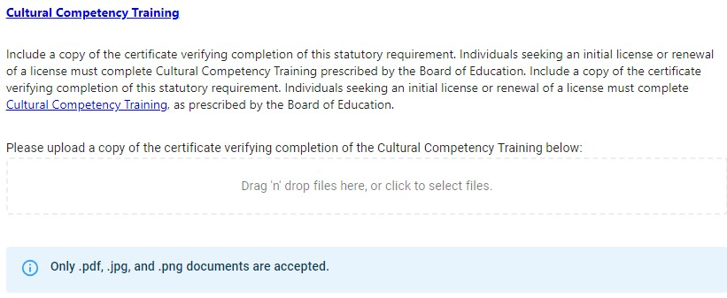
Skip uploading Cultural Competency Training

Slide 23
Do not click the check boxes and click Demographics

Slide 24
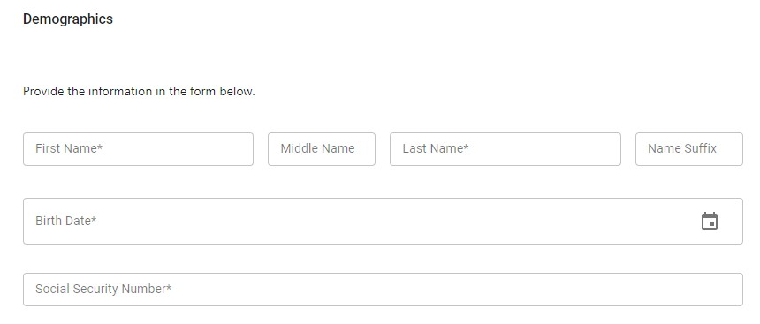
Fill in your demographic information

Slide 25
Fill in your demographic information

Slide 26
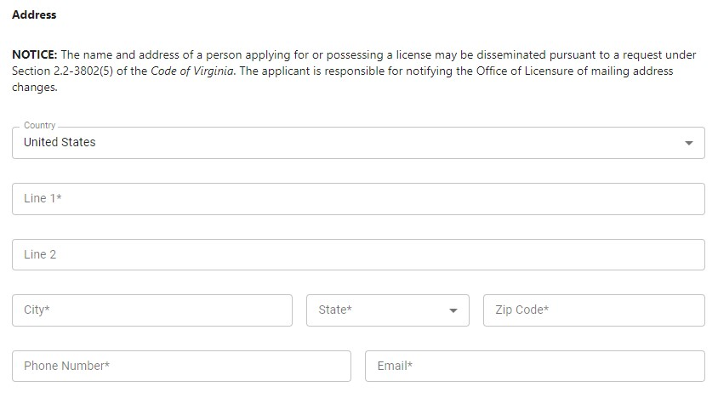
Fill in your address, phone number and email

Slide 27
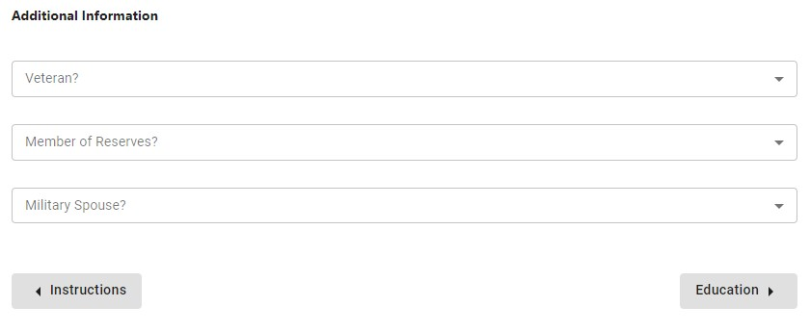
Answer the additional information questions and click education

Slide 28
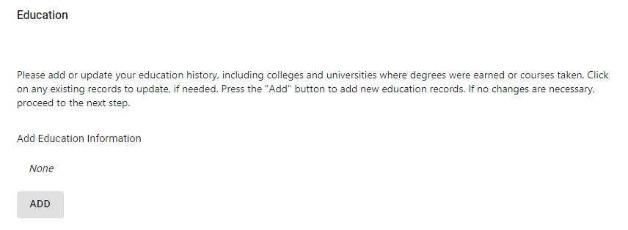
Click the ADD button and enter all colleges/universities you attended

Slide 29
Click on Employment

Slide 30
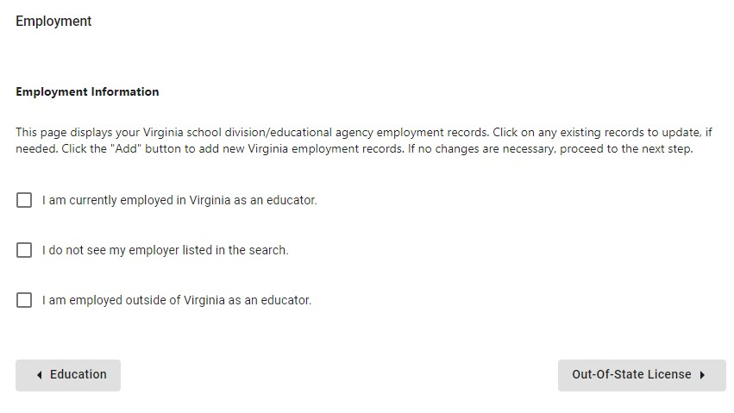
Select the box that applies to you If none of the boxes apply to you, leave the boxes blank Click the Out-Of-State License box to proceed to the next page

Slide 31
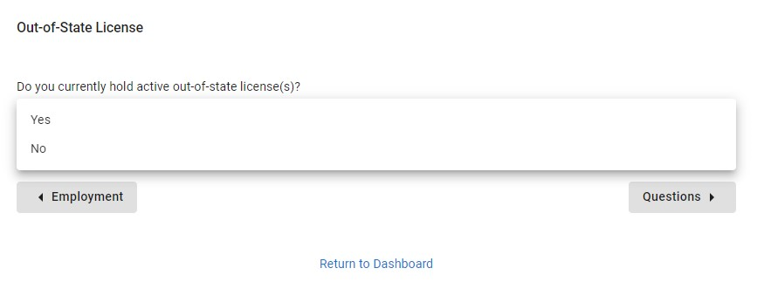
Indicate if you have an out of state license and click Questions

Slide 32
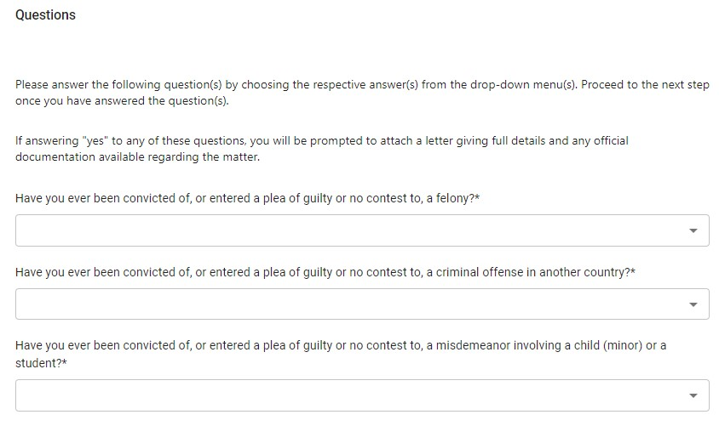
Answer all of the questions truthfully

Slide 33
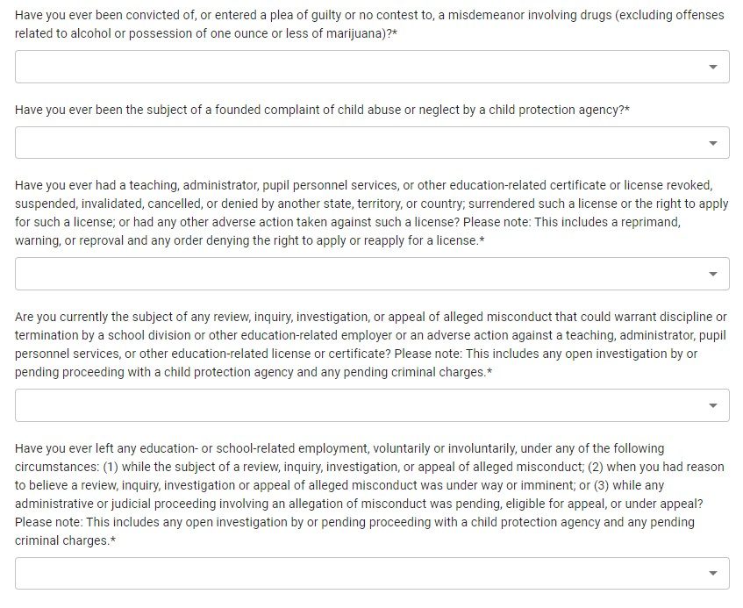
Answer all of the questions truthfully

Slide 34
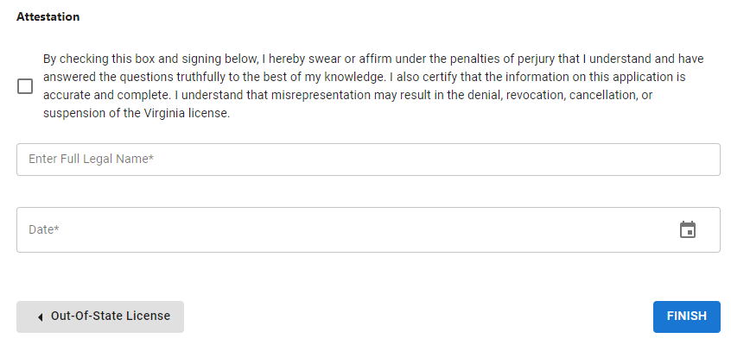
Check the box, sign your name, enter the date, and click FINISH

Slide 35
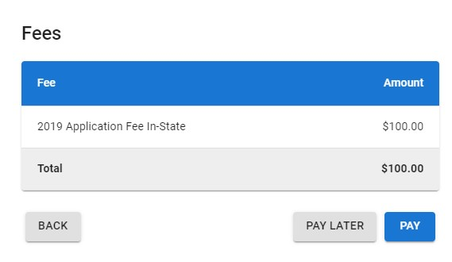
To pay the fee click on Pay Your application will not be submitted until the payment is complete The fee is $100 for in state residents and $150 for out of state residents

Slide 36
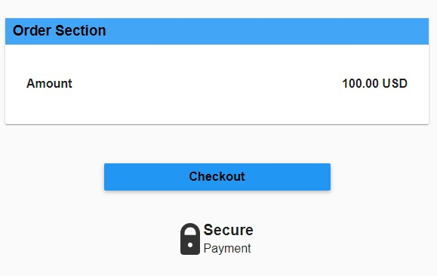
Click on Checkout

Slide 37
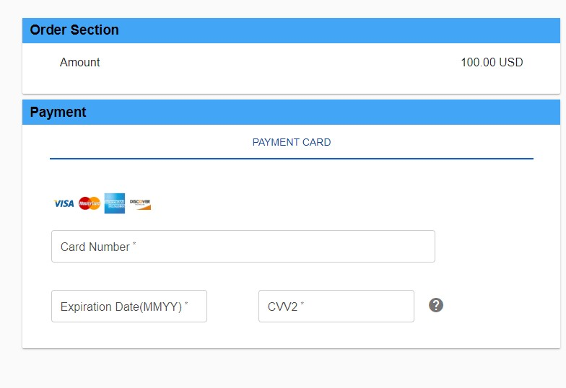
Enter your credit card information

Slide 38
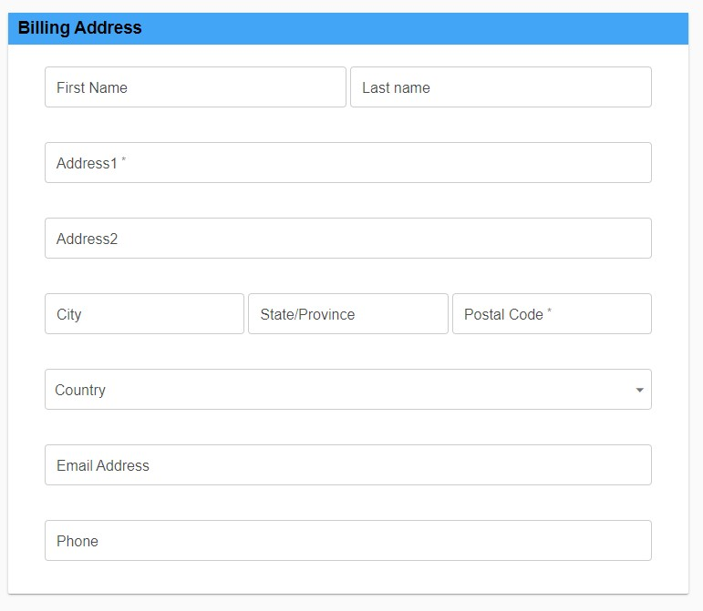
Enter your billing address, email, and phone number

Slide 39
Click on Submit Payment – this will submit your application

Slide 40
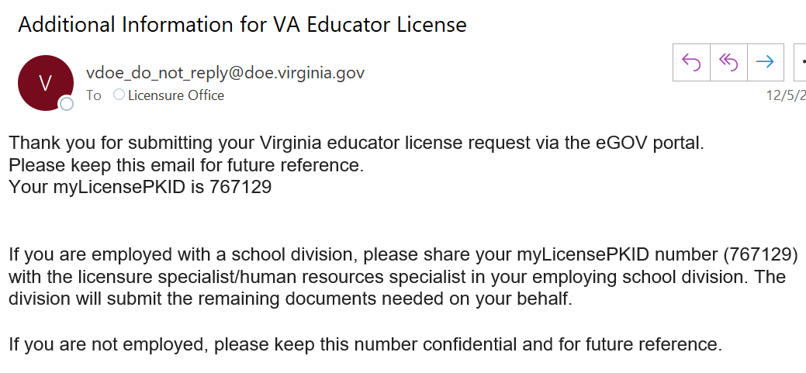
Once you submit your application you will receive an email with your myLicensePKID
Your 6 digit PKID will be listed here
THIS NUMER IS VERY IMPORTANT – SAVE THIS EMAIL FOR YOUR RECORDS

Slide 41
Official Transcripts
Order an official transcript for EACH university/institution you have attended
Visit this website to order official transcripts from GMU
Ordering a transcript to be delivered electronically via email to edlicen@gmu.edu is the preferred option as it is the fastest option
Scanned copies of official transcripts will not be accepted
Opened envelopes containing paper official transcripts will not be accepted
If you mail an official transcript to yourself to include in your application packet, do not open the envelope
If you mail your official transcript have it sent to this address:
George Mason University
Attn: Licensure
4400 University Dr., MSN 6C13
Thompson Hall, Room 2204
Fairfax, VA 22030

Slide 42
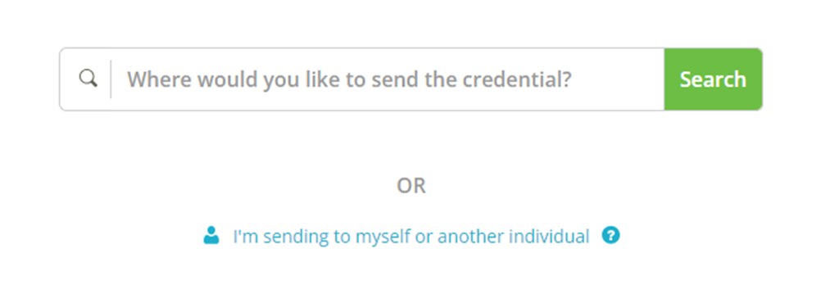
Visit this website to order official transcripts through parchment
Choose I’m sending to myself or another individual
Then select I am sending this to another individual

Slide 43
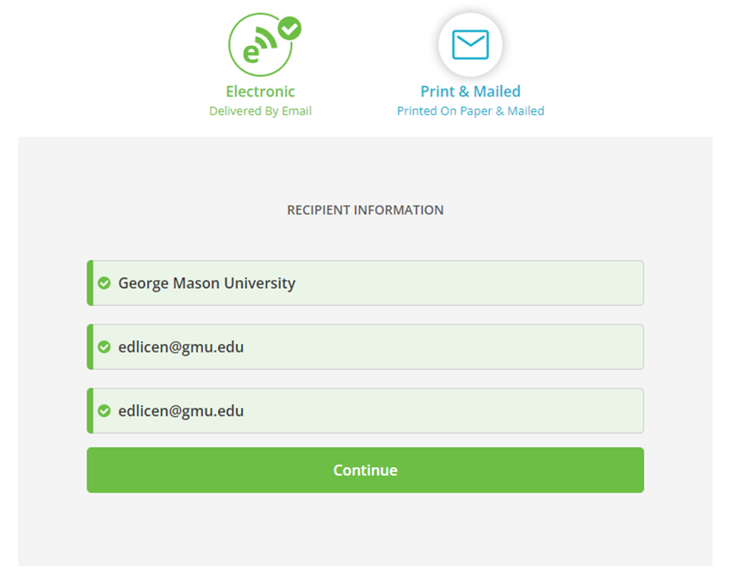
Send an electronic official transcript
Enter the recipient information
George Mason University
edlicen@gmu.edu
Do not enter your information
Hit continue

Slide 44
Part two – contacting the GMU licensure coordinator
Once you have submitted your online application, you will need to complete the Student Information Form with the following information
Birthday
Full Name
Social Security Number
Mailing address
G Number
Program you completed at GMU (i.e., special education, elementary education, music)
The licensure coordinator needs this information to complete your college verification form for VDOE review

Slide 45
Part two – contacting the GMU licensure coordinator
Once you have received your myLicensePKID number, ordered official transcripts, and completed the Student Information Form, you will need to email the GMU Licensure Coordinator at edlicen@gmu.edu
The subject line of your email should be Online Application Submitted – Request for CVF
Your email to the GMU licensure coordinator will need to include the following information
Your name
Your G Number
Your myLicensePKID number (this number is how the licensure coordinator can upload your CVF and transcripts to your application)
A statement that you have submitted your online application through VALO, ordered your official transcripts, and are ready for your College Verification Form to be completed
Please review the next slide to see what documents need to be attached

Slide 46
Attach the following items to your email to the GMU licensure coordinator
Certificate for completion of Behavior Intervention and Support Training
Certificate for completion of Child Abuse and Neglect Recognizing, Reporting, and Responding Training
Certificate of completion of Dyslexia Awareness Module
Copy of American Red Cross or American Heart Association Certificate for CPR/AED/Emergency First Aid
If applicable, certificate of completion of Cultural Competency

Slide 47
Next steps
Once you email the licensure coordinator at edlicen@gmu.edu, the licensure coordinator will review your academic record to ensure all licensure requirements are satisfied and will complete the college verification form
The licensure coordinator will then upload your completed CVF and official transcripts to your application and email you a copy of your CVF for your records
Once the Licensure Coordinator uploads your supporting documentation, the Virginia Department of Education will review your application. Please be patient as it can take a few months for VDOE to review your application and grant licensure. Please keep an eye on your account on vdoe.mylicenseone.com for any updates from VDOE.

